Slide 1
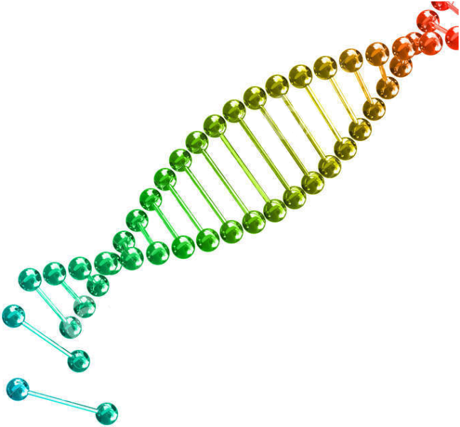
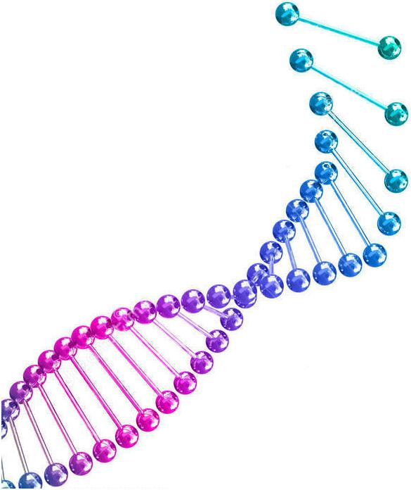
ESF/EuroCleftNet Project Overview on Oligo Pulldown Assay
September 9th, 2014
F. Conte

Slide 2
Oligo pulldown assay What is it? Why do we use it?
The DNA pulldown assay is a method used to selectively detecting all the DNA-binding proteins which bind a specific sequence of DNA.
Typically, the DNA oligo is labeled with biotin, useful after the incubation with the nuclear extract for recovering the oligo and all the proteins bound on it by using beads coated with streptavidin.
After the separation, the peptides bound to the sequence are eluted from the oligo and analyzed by: A) Western blot;
or
B) mass spectrometry.

Slide 3
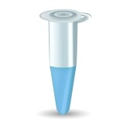
(0) Oligonucleotide annealing
Oligonucleotide structure:
ext motif ext
Forward – biotinylated
(min. length 59 nt)
Reverse – not tagged oligo
Annealing buffer
+ Fw primer
+ Rev primer
Oligonucleotide annealing
Notes:
In our first experiment, the oligo extensions are the natural flanking sequences of that p63 binding motif.

Slide 4
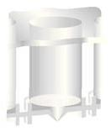
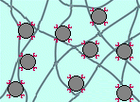
Filter plate
Beads coated
with streptavidin
(1) Plate washing
membrane
(2) Bead equilibration
Bead solution
Situation in the membrane (after bead addition)

Slide 5
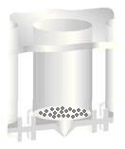
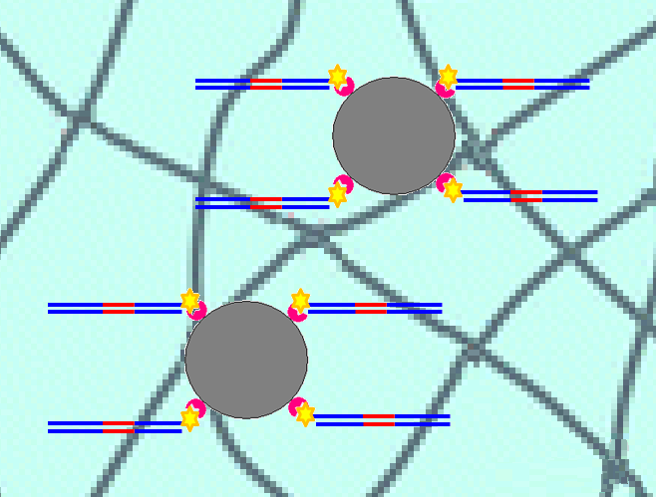
(3) Immobilization of oligonucleotides to beads
Oligos
Incubation
Remaining oligos
(without streptavidin)
are washed way
Result
Beads in the membrane with the immobilized oligos
Notes:
Thanks to streptavidin/biotin interactions, the annealed oligos are immobilized on the beads in the membrane.

Slide 6
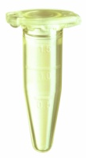
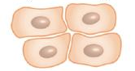
(4) Nuclear extraction incubation
Nuclear proteins
Gingival keratinocytes
Nuclear extract (≈ 5 mg/ml)
Incubation
Remaining nuclear proteins (which don’t bind to the motif)
are washed away
Result
Beads in the membrane with the immobilized oligos and the proteins (DNA binding factors) bound on the motif
Notes:
In the membrane of the well (circular detail picture): beads with immobilized oligos in the membrane

Slide 7
(5) Reduction and alkylation of disulfide bonds
Inside the membrane…
R–S — S–R
Because disulfide bonds prevent trypsin digestion (following step), we add:
• TAEB (100mM) + TCEP (5mM) → reduction
• MMTS (10 mM) → alkylation
R–SH HS–R
Result
Notes:
Reduction: to break the disulfide bonds
Alkylation: to avoid the reformation of disulfide bonds after trypsin digestion

Slide 8
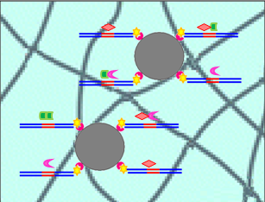
(6) Trypsin digestion
Trypsin
molecules
Trypsin/LysC
During incubation…
Incubation
After trypsin digestion, the peptides are present in the supernatant.
Notes:
In the membrane of the well (circular detail picture): beads in the membrane, with immobilized oligos and proteins bound on the motif.
During the incubation: the trypsin cuts (Lys) the proteins, generating small peptides.

Slide 9
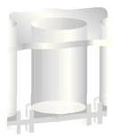
(7) Sample collection
Filter plate
Peptides in the supernatant
Vacuum pump
New collection plate
Notes:
Note: there is NOT a membrane in the bottom of collection plate wells!

Slide 10
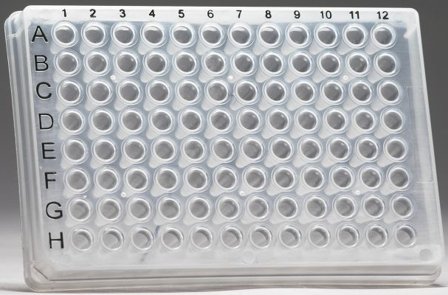
Focus on…
How t I have organize the plate
Considering all the wells (8 in my exp):
SNP oligo | WT oligo (+) | AM oligo (–) | WT oligo (+)
WT oligo (+) | SNP oligo | WT oligo (+) | AM oligo (–)
SNP WT AM WT
WT SNP WT AM
Notes:
3 TYPES of oligo, based on the same p63 binding motif:
WT (positive control) = oligo containing the binding motif with its wildtype sequence.
AM (negative oligo) = oligo containing the binding motif with all the four most important positions mutated (nt n.3, 6, 13, 16).
SNP = oligo containg the binding motif with one mutation in one of the four most important positions.

Slide 11
(8) Dimethyl labelling
4 µl 4% LIGHT label (CH₂O)
4 µl 4% MEDIUM label (CD₂O)
1
2
To start the labelling reaction, add in every well 4 µl NaBH₃CN (0.6M)
Incubation
To stop the labelling reaction, add in every well 16 µl 1% ammonia
Notes:
In the first line (4 wells, green arrows) we add the light labelling solution.
In the second line (4 lines, red arrows) we add the medium labelling solution.

Slide 12
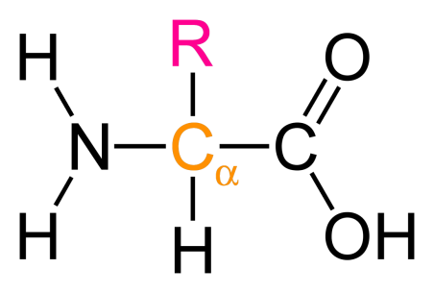
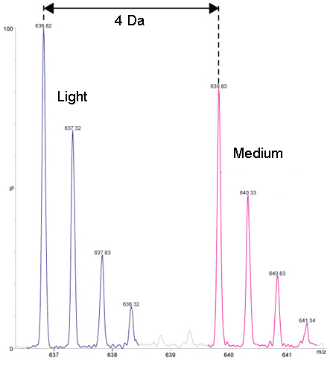
What happens during the incubation
Focus on…
Normal amino acid
structure:
OH₂C
Light labelled amino acid structure:
OH₂C
OD₂C
Medium labelled amino acid structure:
OD₂C
Example: peak patterns of the same peptide, bound with LIGHT label (on the left) and with MEDIUM label (on the right).
Notes:
CH₂O (and CD₂O) replaces the H atom in NH₂: this happens in all the amino acids of each peptide. The result is that all the peptides are labelled.
NOTE: to have this type of bond pattern on atom N, the atom O of CH₂O (and of CD₂O) had to be negatively charged!

Slide 13
We mix the samples because we use the ‘combined’ protocol
(9) Sample mixing
SNP WT AM WT
WT SNP WT AM
Result
Four merged samples
SNP (L) vs WT (M)
SNP (M) vs WT (L)
AM (L) vs WT (M)
AM (M) vs WT (L)
In the four wells containing the merged samples, add 5 µl 100% TFA
Notes:
NOTE: 100% TFA (trifluoroacetic acid) has the function to give H⁺ in the solution (neutralization).

Slide 14
Two different types of oligo pulldown protocol
Further information…
There are two different way to analyze the samples after the pulldown:
You can continue to work on your samples separately and, at the end, you have to load your samples in stage tips separately as well.
In other words: for instance, if you start with 8 samples, using this protocol at the end you will use 8 stage tips.
In this way, the mass spec device will elute and analyze one sample at a time, which contains just one type of oligo.
• Advantage: no information loss.
• Disadvantages: much more time; more materials.
You can combine the couples of differentially labelled samples and then load this mixed solution directly in one stage tips (one stage tip for each couple).
Example: sample containing SNP oligo + sample containing WT oligo = one mixed sample!
NOTE: in this case, before to merge the couples of samples, you have to differentially label the peptides of those samples you want to mix (in order to make them recognizable/distinguishable).
In this way, the mass spec device will elute and analyze two samples (mixed together) at a time.
• Advantage: less time; less material.
• Disadvantages: loss of information.
NOTE: At the end of this protocol, the mass spec device measures the ratio among the strength with which the factors bind the control oligo and the strength with which they bind the mutant oligo.
Notes:
‘Single sample’ protocol (A): the device takes much longer because the sample needs to be deeper sequenced and, in addition, the device has to run/elute/analyze one sample at a time containing only one oligo [instead of two, as happens in the “combined’ protocol].
In this protocol (A), at the end you get a list of DNA-binding factors which bind the sample you are considering, base on their elution time. [Instead, in protocol B, the device evaluates the ration between bond strengths!].

Slide 15
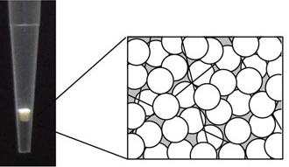
(9) Sample mixing
SNP vs WT (fw)
SNP vs WT (rev)
AM vs WT (fw)
AM vs WT (rev)
Four merged samples
Stage tips with C18 filter
Store the loaded stage tips at 4°C indefinitely
before elution (mass spec device).
Notes:
fw = forward experiment
rev = reverse experiment
The reason why we perform both the experiments, forward and reverse, is that we need a QUALITY CHECK: if a DNA-binding factor binds specifically the motif sequence, it will be present in both the experiments.

Slide 16
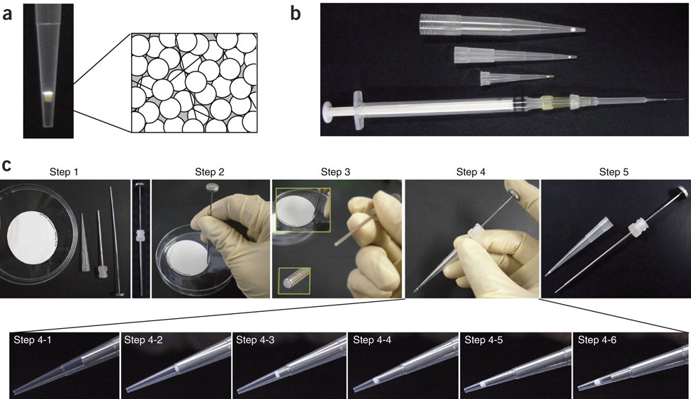
How to prepare the stage tips
Focus on…
C18 structure
Protocol for micro-purification, enrichment, pre-fractionation and storage of peptides for proteomics using StageTips, Nature Protocol [2007], Rappsilber et al. Figure link: http://www.nature.com/nprot/journal/v2/n8/fig_tab/nprot.2007.261_F1.html
Notes:
NOTE: the filter is formed of three layers of C18.
The stage tips have to be washed (several washing steps with MeOH, then buffer B, then buffer A) before to load the samples.

Slide 17
RESULTS from 1st experiment (12-13/8/2014)

Slide 18
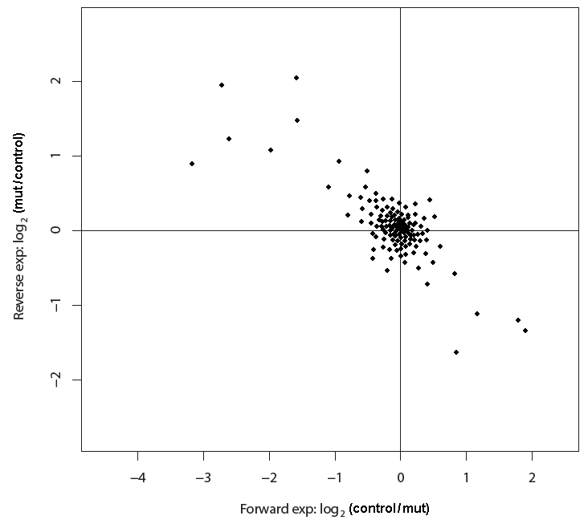
Example
How to read a result plot
Cloud of spots (in the middle of the axes) contains:
the factors which bind equally both the control seq and the mutated seq
and
the factors which don’t bind anything at all.
North-West quadrant contains all the binding factors which bind much stronger the mutated sequence than the control.
South-East quadrant contains all the binding factors which bind much stronger the control sequence than the mutated one.
Outliers
(= interesting factors)
Notes:
NOTES:
Scale: log₂
Rev exp on y axis; fw exp on x axis.
3) The outliers have to be SIGNIFICANT! In other words, the strength of their bonds with control [south-east quad] or mutated sequence [north-west quad] has to exceed a threshold to make them significant.

Slide 19
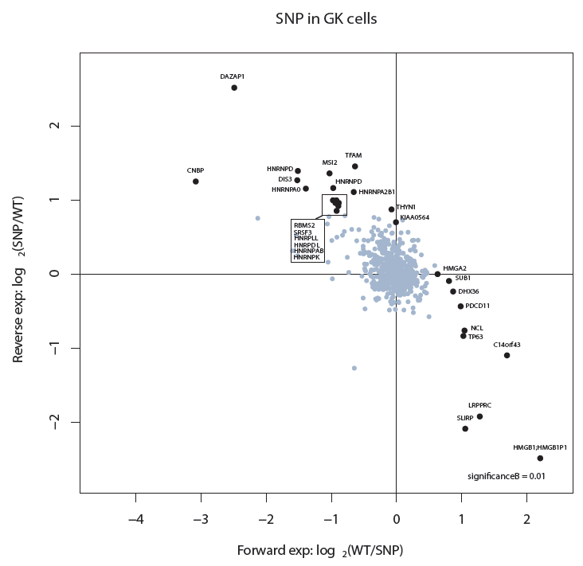
Oligo pulldown assay (1st assay, 12-13/8/2013)
RESULT 1
Experiment with: WT oligo (control) + oligo containing the SNP

Slide 20
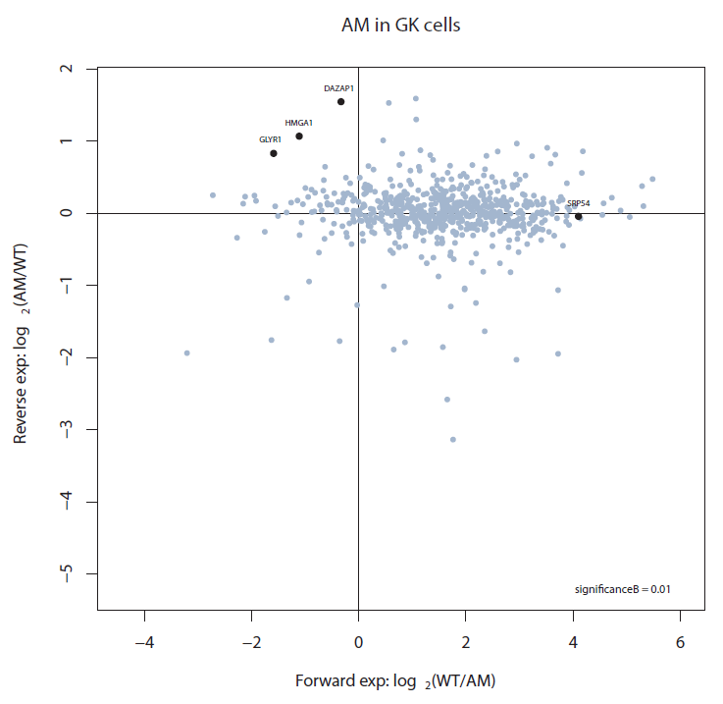
Oligo pulldown assay (1st assay, 12-13/8/2013)
RESULT 2 (version A)
Experiment with: WT oligo (control) + all mutated oligo (AM)
Using the correct statistics, all these outliers are NOT significant!

Slide 21
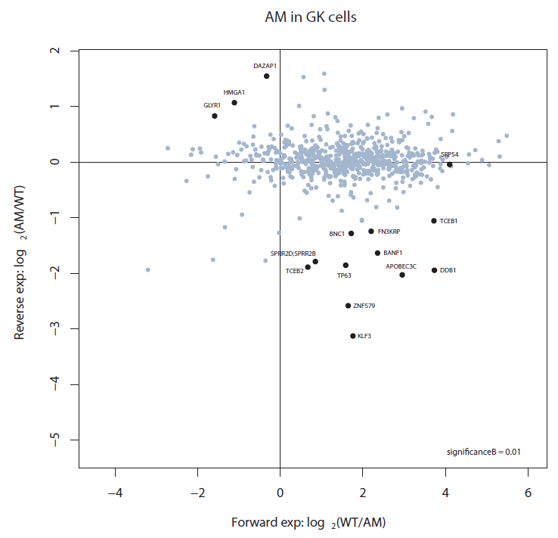
Oligo pulldown assay (1st assay, 12-13/8/2013)
RESULT 2 (version B)
Experiment with: WT oligo (control) + all mutated oligo (AM)
So Luan has decided to correct manually the plot, just to check the outliers (even if they are not significant)!

Slide 22
Oligo pulldown assay:
Because the cloud of spots in the second plot
(experiment: WT + AM)
is spread along the horizontal axis and
it appears different from our expectations,
we have decided to repeat this last experiment,
in order to get a better plot with significant outliers!

