Slide 1
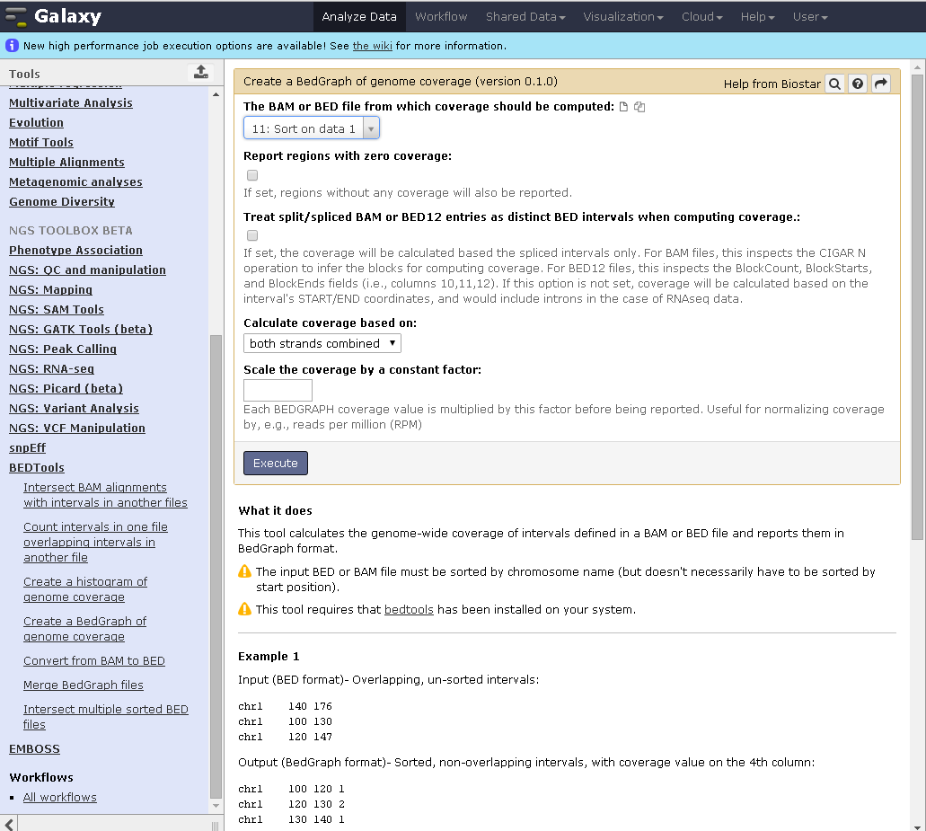
Something went wrong…
Note: these options are NOT selected

Slide 2
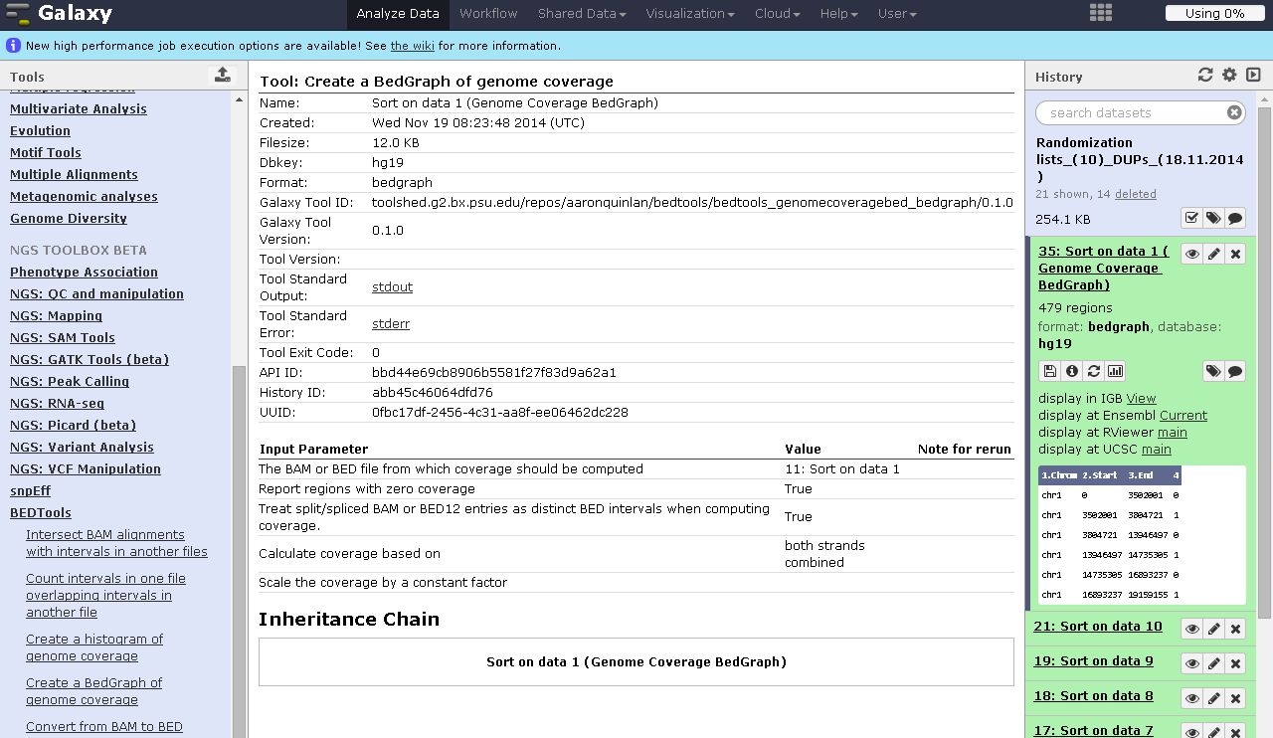
…because the result is wrong
Instead, I expected: False/False!!

Slide 3
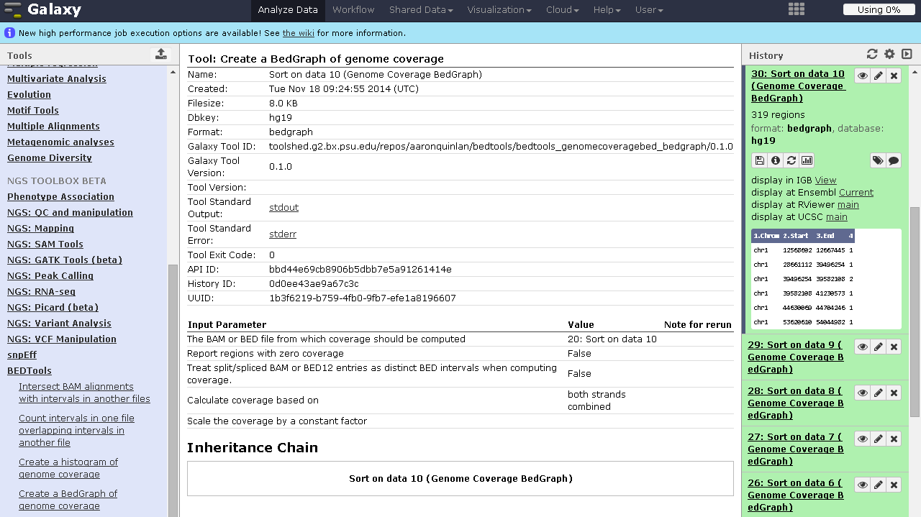
Example of a correct result from yesterday morning (setting the same conditions shown in slide 1)
Right!

