Slide 1


Tuesday Meeting at Dentistry Dept.
July 7th, 2014
Last week…
0 – Presentation for Skype-call to update Prof. Rubini
1 – Cross-checking between the genes contained in the overlapping regions (identified from Decipher patients) and the genes identified by exome-seq.
2 – Cross-checking between GWAS data and the overlapping regions (identified using Decipher patients).
3 – Detail collection of interesting genes contained in overlapping regions (DELETIONS) .

Slide 2
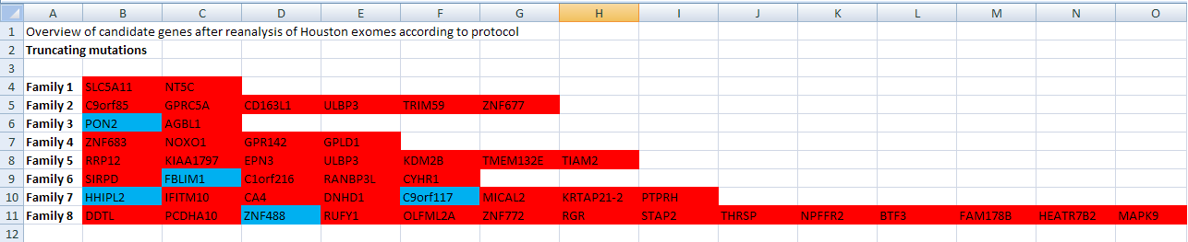
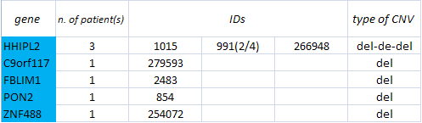
(1) Cross-checking between exome-seq genes and genes contained in overlapping regions
From Charlotte’s file
5 genes are present in both the lists:
the list of genes identified by using exome-seq AND
in my list of genes contained in the overlapping regions.

Slide 3
HHIPL2 (Hedgehog Interacting Protein-Like 2)
The functions of its protein include quinone binding and oxidoreductase activity, acting on the CH-OH group of donors, quinone or similar compound as acceptor.
A disease associated with this gene is thyroiditis.
C9orf117 (Chromosome 9 open reading frame 117)
Its functions are still unknown.
Diseases associated with C9orf117 include malaria.
FBLIM1 (Filamin binding LIM protein 1)
This protein localizes at cell junctions and may link cell adhesion structures to the actin cytoskeleton. This protein may be involved in the assembly and stabilization of actin-filaments and likely plays a role in modulating cell adhesion, cell morphology and cell motility.
Diseases associated with FBLIM1 include skin atrophy and kindler syndrome.
PON2 (Paraoxonase 2)
The encoded protein is ubiquitously expressed in human tissues, membrane-bound, and may act as a cellular antioxidant, protecting cells from oxidative stress. Hydrolytic activity against acylhomoserine lactones, important bacterial quorum-sensing mediators, suggests the encoded protein may also play a role in defense responses to pathogenic bacteria.
Defects in this genes are associated with vascular disease and a number of quantitative phenotypes related to diabetes. Diseases associated with PON2 include coronary artery disease, and multiple chemical sensitivity.
ZNF488 (Zinc Finger Protein 488)
The functions related to the encoded protein include sequence-specific DNA binding RNA polymerase II transcription factor activity.
Diseases associated with ZNF488 include ataxia and alzheimer's disease.

Slide 4
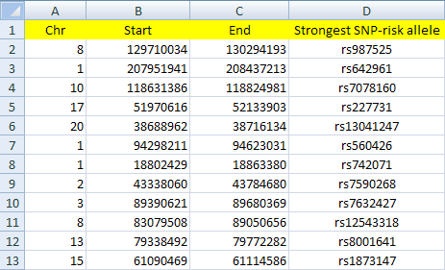
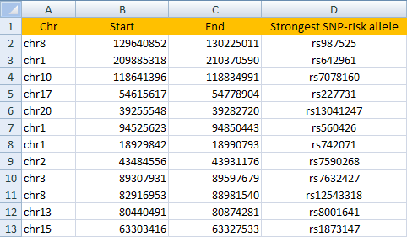
(2) Cross-checking between GWAS data and the overlapping regions (identified using Decipher patients)
Assembly: hg18
Assembly: hg19
LiftOver tool
Then, using UCSC Custom Track I displayed at the same time the GWAS data (in orange), the overlapping deletions (in black) and overlapping duplications (in grey) identified from Decipher patients.

Slide 5
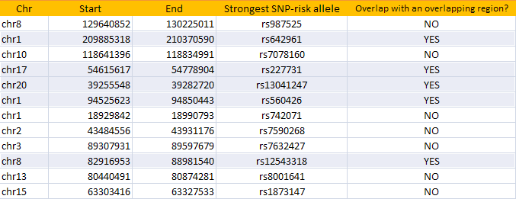
Result tab
5 GWAS regions overlalp with the identified overlapping regions:

Slide 6
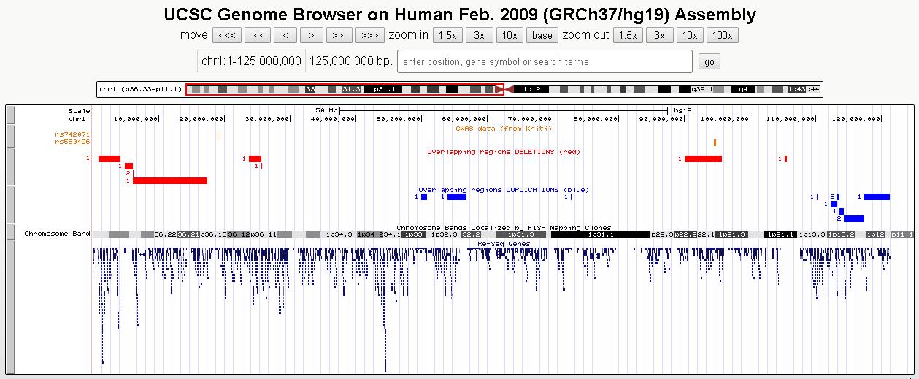
Result visualization using UCSC Custom Track...
Chr 1p (rs540426, rs742071)

Slide 7
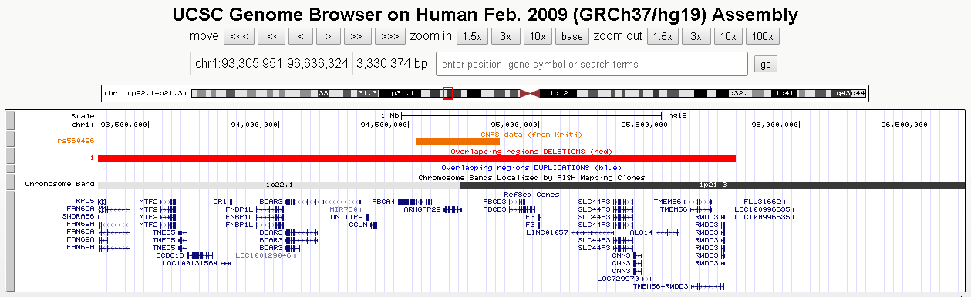
Chr 1p - ZOOM ON rs540426

Slide 8
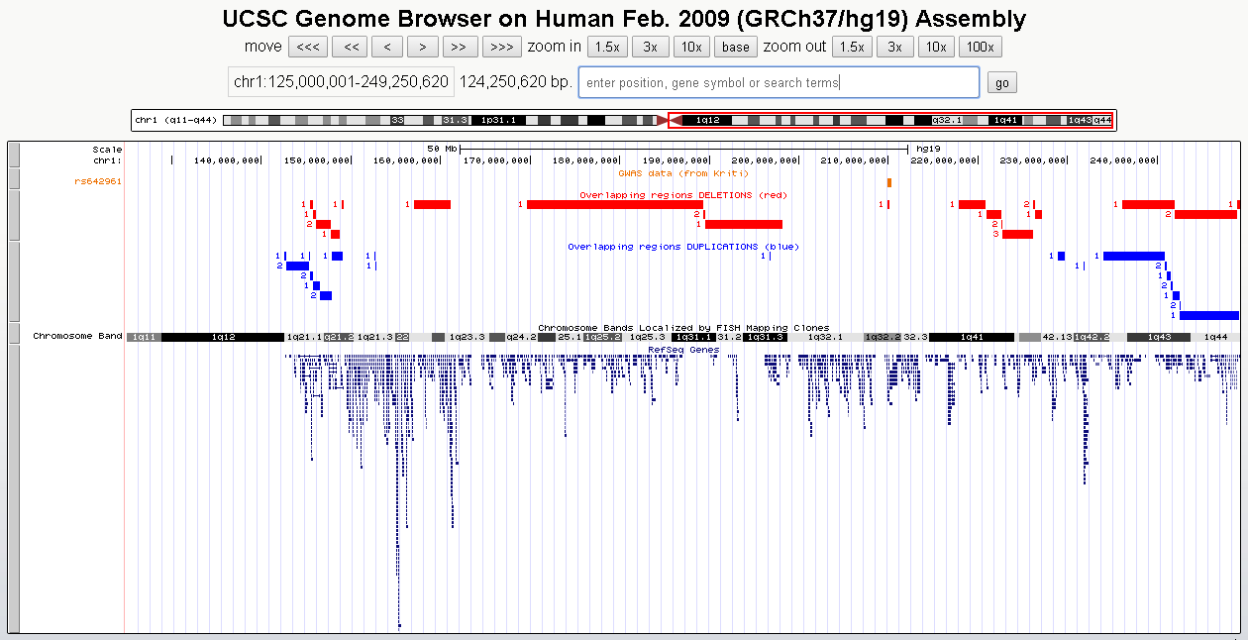
Chr 1q (rs642961)

Slide 9
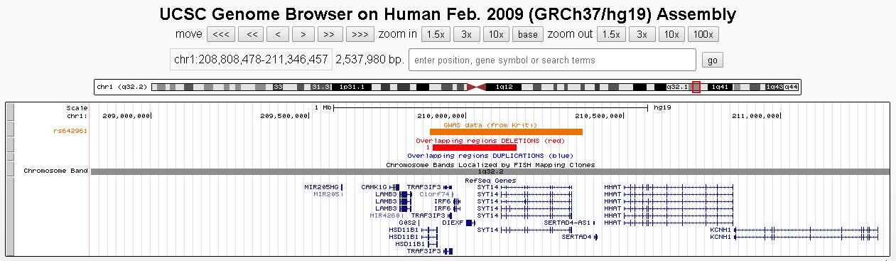
Chr 1q - ZOOM ON rs642961

Slide 10
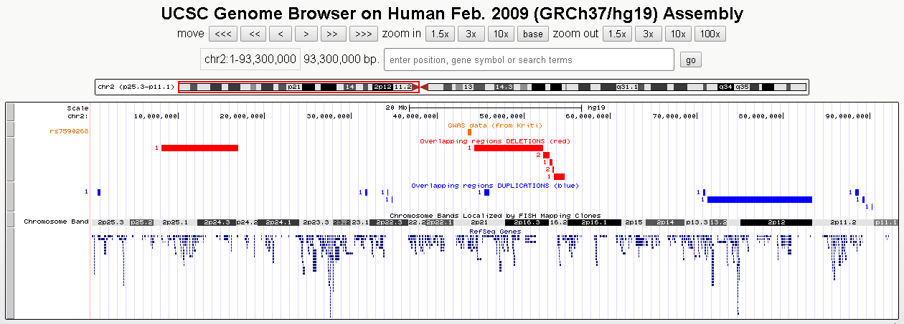
Chr 2p (rs7590266)

Slide 11
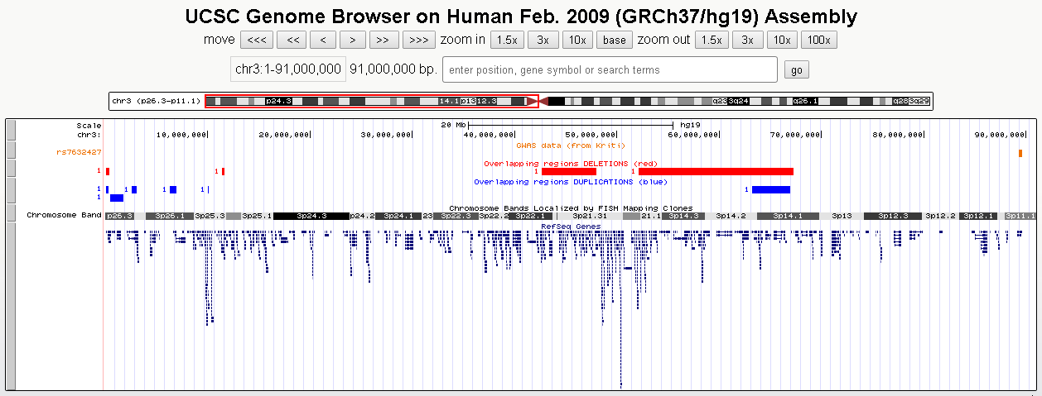
Chr 3p (rs7632427)

Slide 12
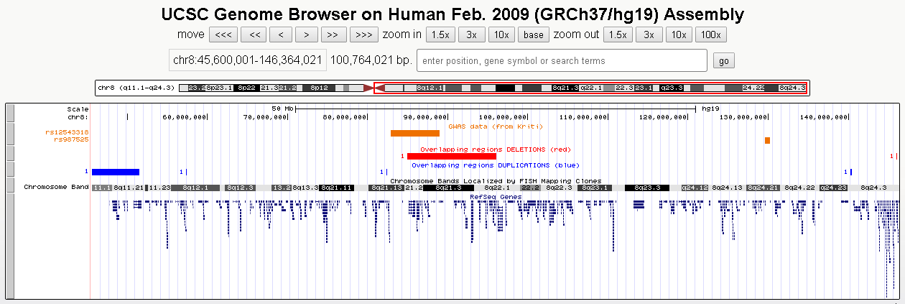
Chr 8q (rs12543318, rs987525)

Slide 13
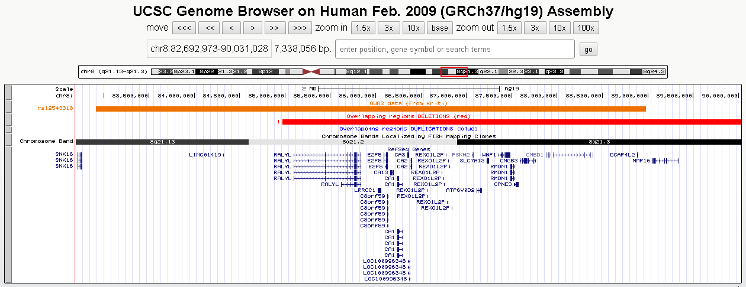
Chr 8q - ZOOM ON rs12543318

Slide 14
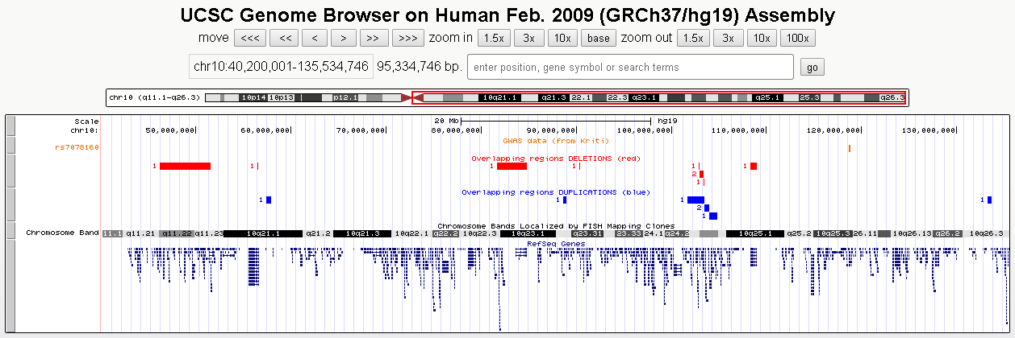
Chr 10q (rs7078160)

Slide 15
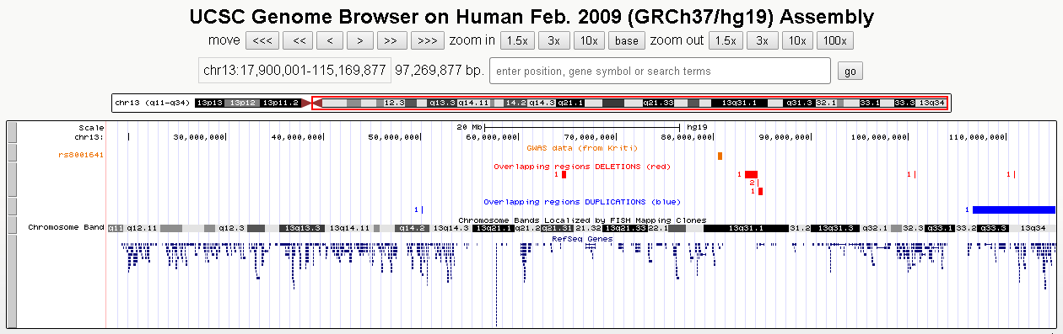
Chr 13q (rs8001641)

Slide 16
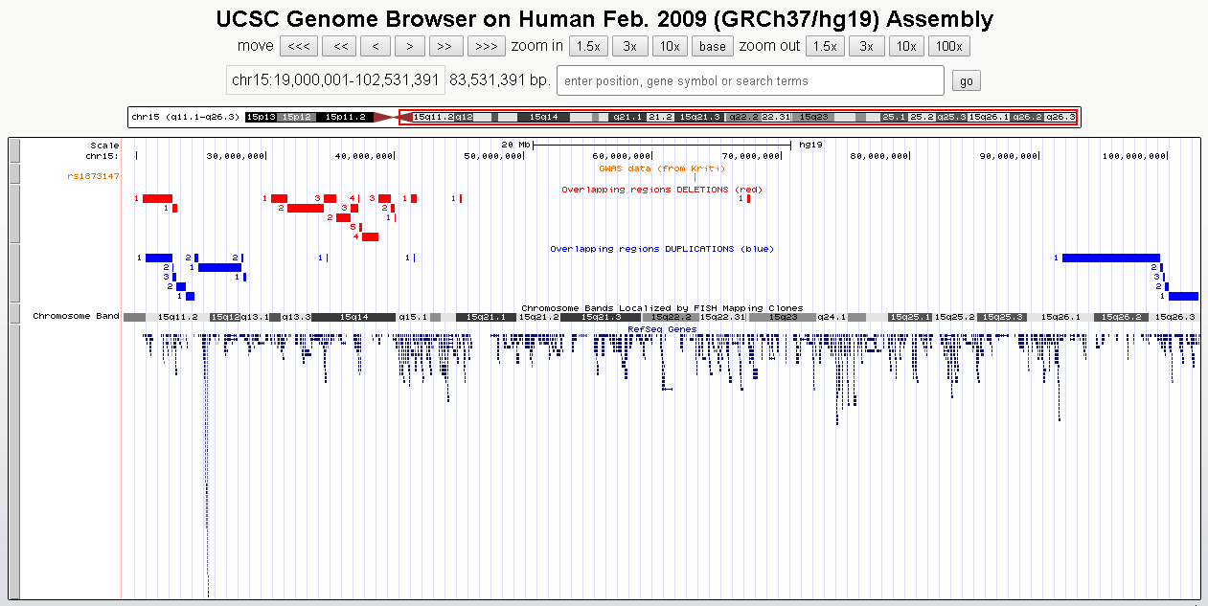
Chr 15q (rs1873147)

Slide 17
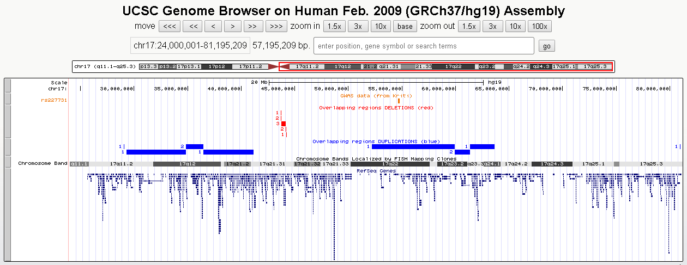
Chr 17q (rs227731)

Slide 18
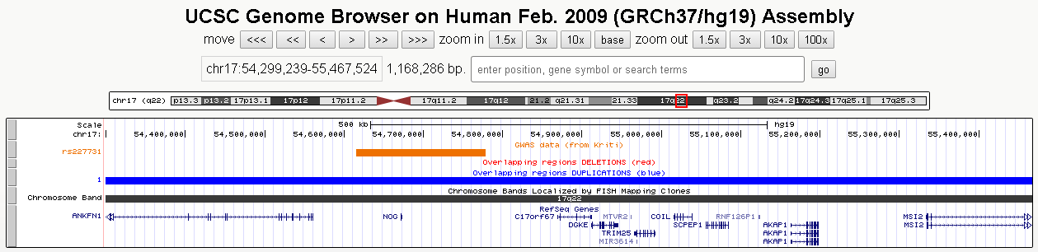
Chr 17q - ZOOM ON rs227731

Slide 19
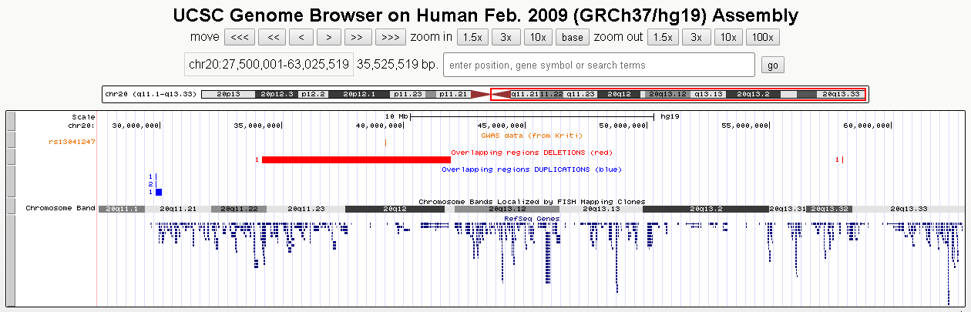
Chr 20q (rs13041247)

Slide 20
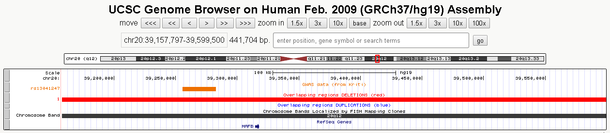
Chr 20q - ZOOM ON rs13041247

Slide 21
(3) Detail collection of interesting genes contained in my overlapping regions (DELETIONS)
We decided to go through the gene lists of overlapping regions in order to find the presence of genes whose functions could be related with cleft development.
The genes were chosen according to these conditions:
firstly, we considered the overlapping regions with the higher num. of overlaps (7, 6, 5, 4 or 3) and which contained from 1 (min) to 5 (max) genes.
(We decided to exclude, at least for now, the regions which contain more than 5 genes!)
AND
secondly, we considered the overlapping with a low num. of overlaps (2) and which contained from 1 (min) to 2 (max) genes.
(We decided to exclude, at least for now, the regions with two overlaps which contain more than 3 genes!)

Slide 22
Detail collection of interesting genes contained in my overlapping regions (DELETIONS)
In total, I checked 82 genes contained in overlapping DELETIONS. The most interesting ones are:
SATB2 (already known cleft-related gene)
MEIS2 (encodes for a homeobox protein → related to development)
TSHZ1 (encodes for a protein involved in transcriptional regulation of developmental processes)
PARD6G (encodes for a proteina involved in adapter protein involved in asymmetrical cell division and cell polarization processes → involved in formation of epithelial tight junctions)
SPRED1 (encodes for a protein involved in stem cell factor receptor binding)
TENM3 (encodes for a protein involved in the differentiation of the fibroblast-like cells in the superficial layer of mandibular condylar cartilage into chondrocytes)
FBN2 (encodes for a component of connective tissue microfibrils which is involved in elastic fiber assembly)
PARD3B (encodes for a protein involved in asymmetrical cell division and cell polarization processes; it may play a role in the formation of epithelial tight junctions)
FGF2 (limb and nervous system development,??) and NUDT6 (is thought to be the FGF2 antisense gene)
FAT4 (encodes for a protein involved in regulating planar cell polarity)
WHSC1 (already known to be related to Wolf-Hirschhorn syndrome)
ZMYND11 (encodes for a protein involved in chromatin remodeling through association with several remodeling factors: it involved in bone development)
CDH7 (encodes for a protein that contributs to the sorting of heterogeneous cell types and the maintenance of orderly structures)
SMURF1 (encodes for a protein plays a key roll in the regulation of cell motility, cell signalling and cell polarity)

Slide 23

This week…
1 – This afternoon (after the RIMLS Cleaning Day): I will finish to collect the details about the interesting genes contained in the overlapping DUPLICATIONS.
Then, I will prepare a summary on Excel.
2 – Tomorrow: I will write a list with the genes containing in the intervals shared between GWAS regions and my overlapping regions (deletions or duplications).
3 – This week: cross-checking between p63 binding site profile and the overlapping regions identified using Decipher patients affected by OFCs (visualization problem!).
4 – As soon as possible: fix the technical problems of ECARUCA and ISCA to improve the number of patients.
Maybe next Tuesday we should be able to start planning the next phase...

