Slide 1
Multi-omics analysis identifies cooperation of transcription factors controlling the specific epithelial cell fate of the corneal epithelium
Jos G.A. Smits

Slide 2
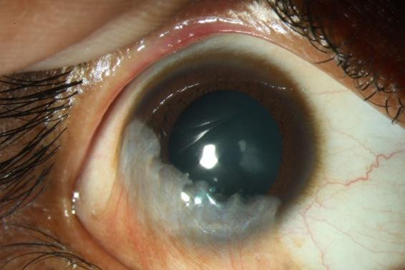
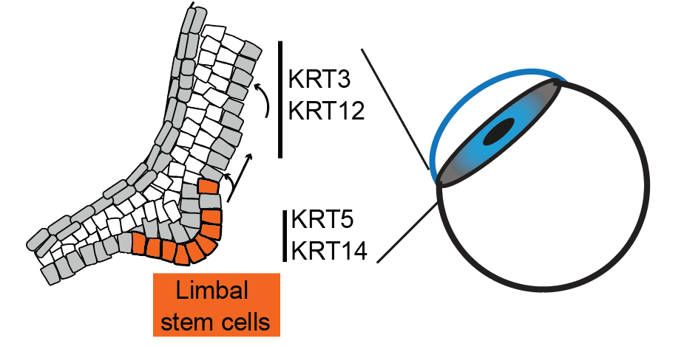
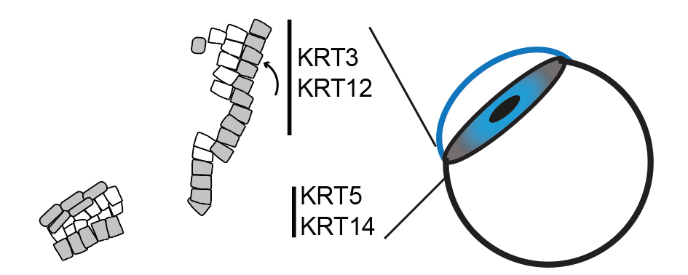
Introduction
corneal epithelium and LSCs
Clinical relevance
LSC deficiency (LSCD) can be caused by:
1. Chemical burn
Conjunctivalization
2. Genetic diseases
-Aniridia (PAX6 mutation)
Loss of LSCs maintaining the cornea
Can we generate LSCs?
Why do LSCs disappear in diseases?
What drives the LSC cell fate?
“what makes a LSCs a LSCs?”
Limbal stem cells (LSC) maintain the cornea

Slide 3
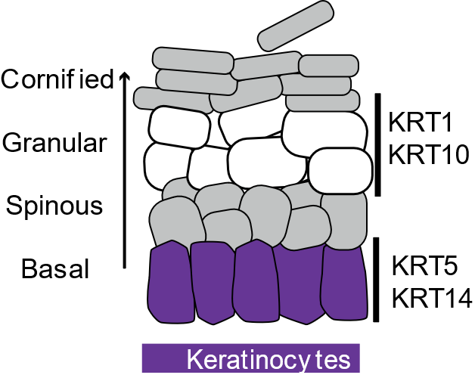
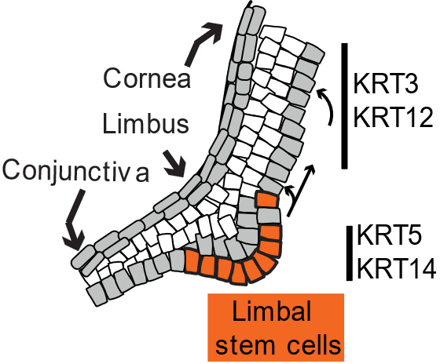
Introduction
Comparing Stratified epithelia
Corneal Epithelium
Epidermis
- PAX6
p63
p63
Transparent
Let light through
+ PAX6
Non-transparent
Support

Slide 4
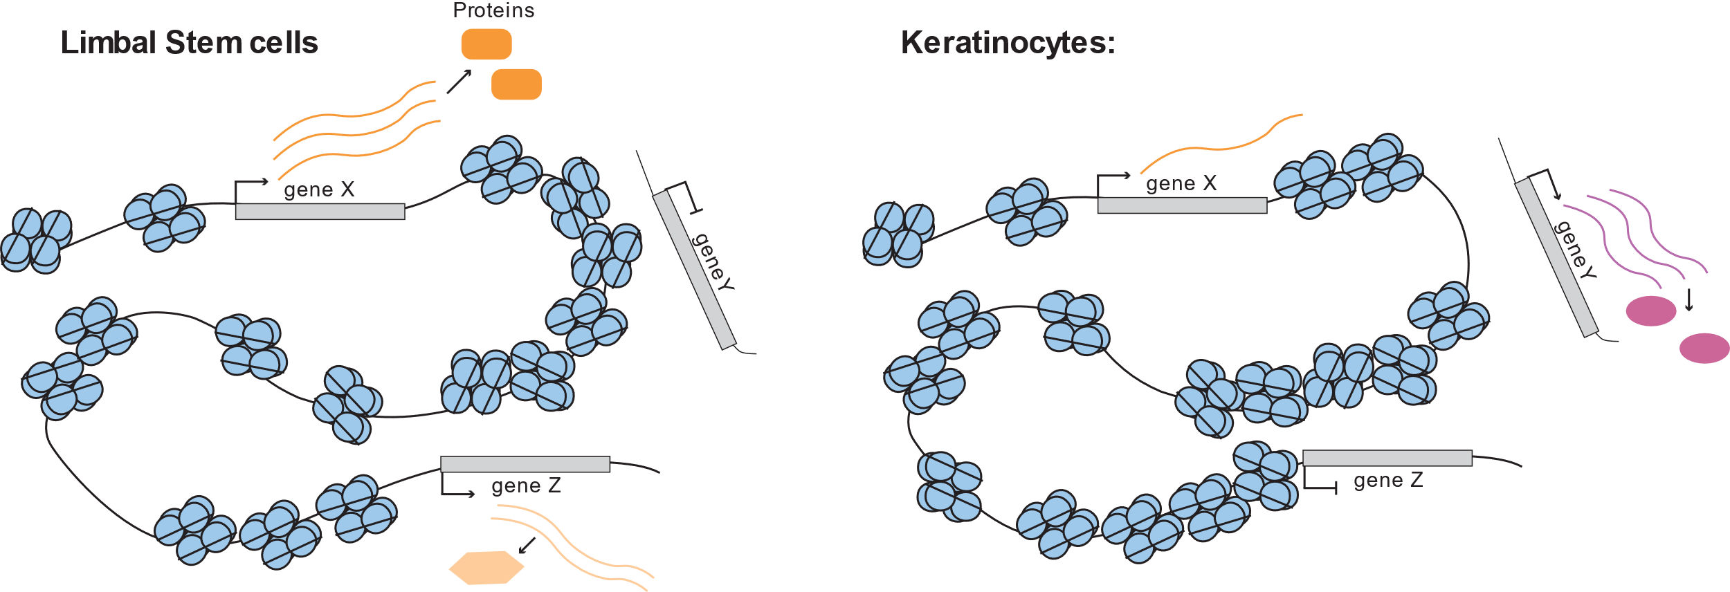
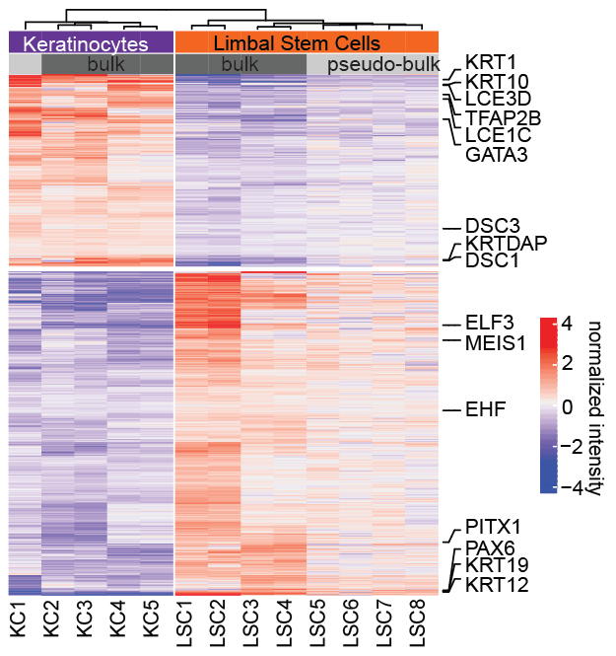
Measure which genes are (differentially) expressed using RNAseq
What drives these expression differences?

Slide 5
What might drive gene Expression differences?
DNA-accessibility
Histone modifications
Transcription factor binding
DNA-accessibility
Histone modifications
Transcription factor binding

Slide 6
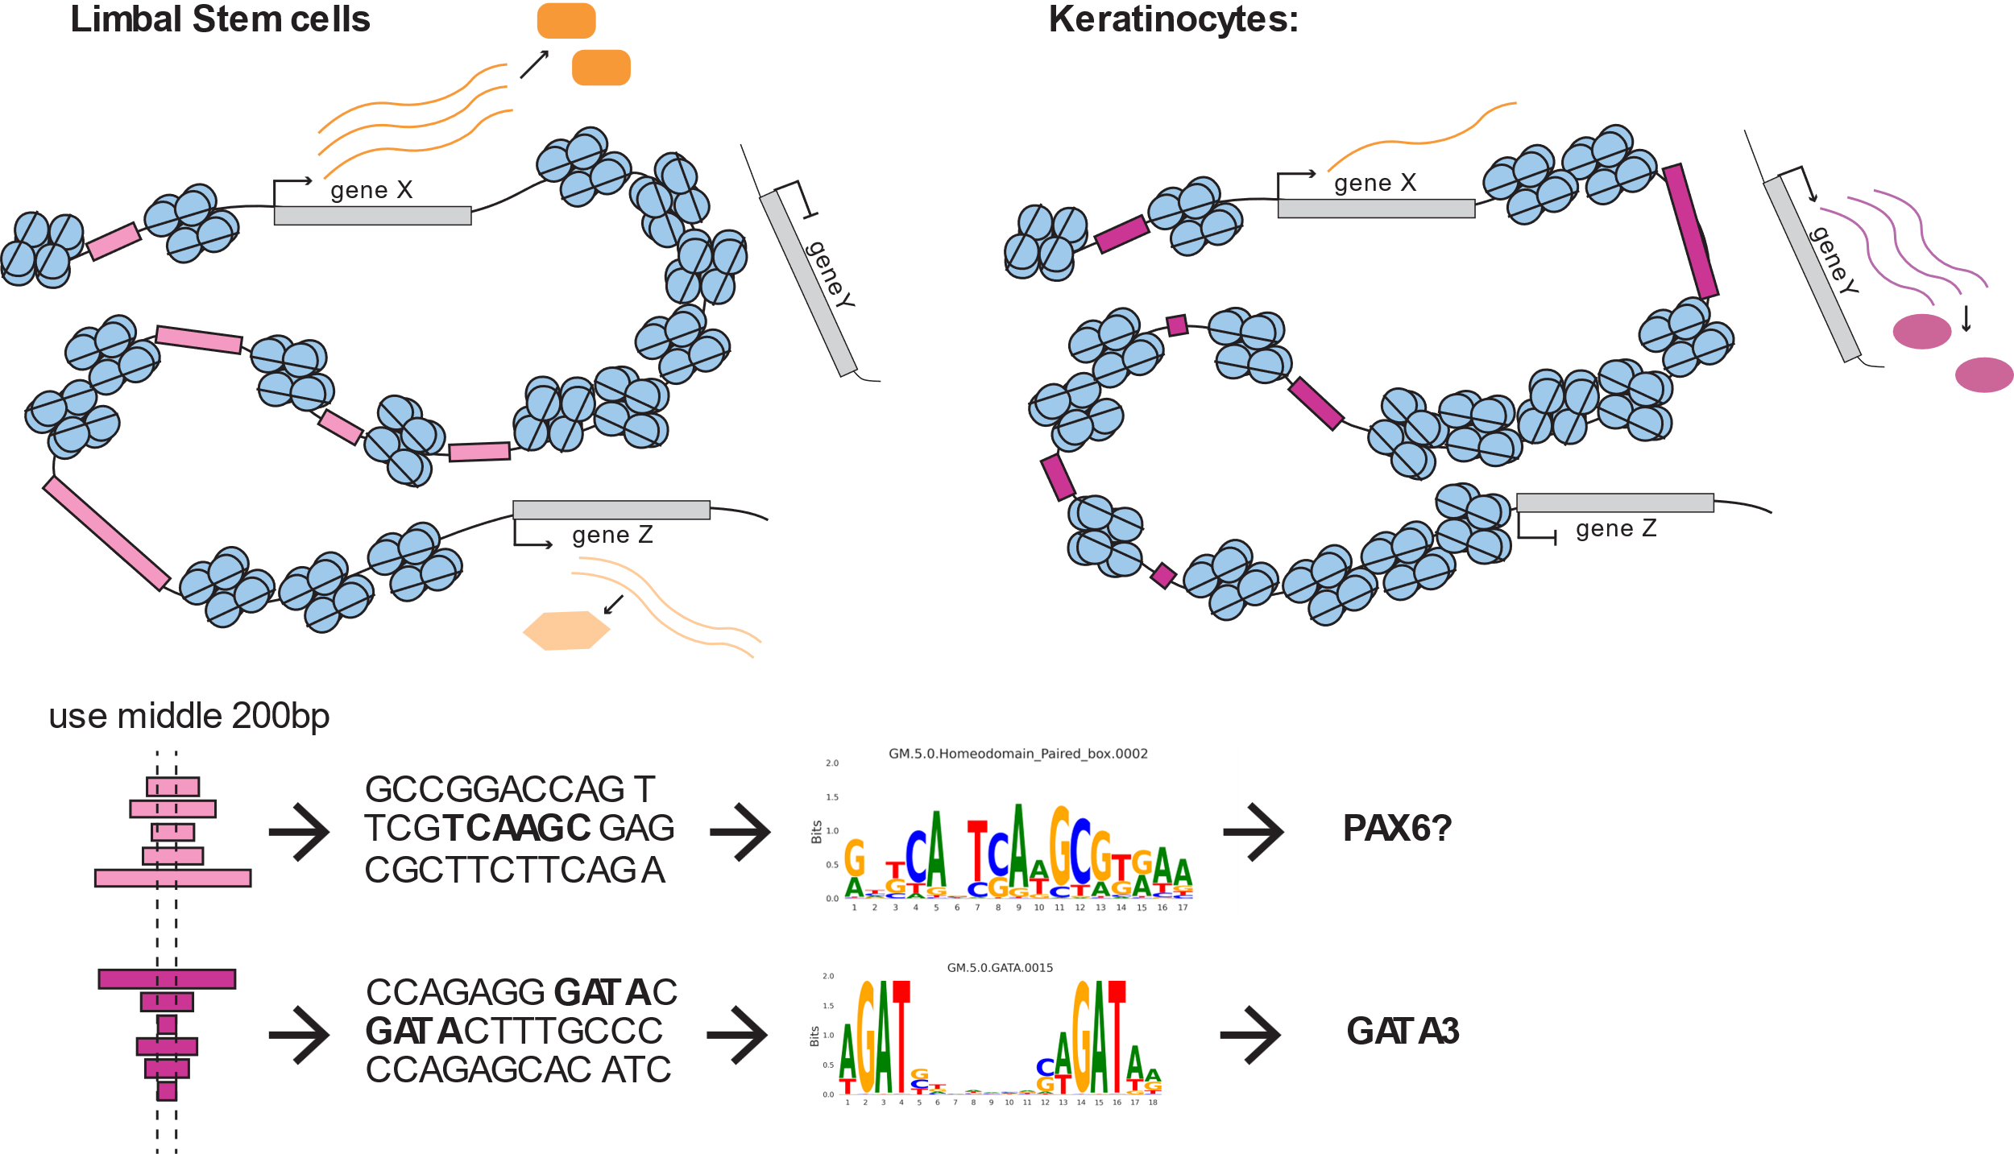
Intelligently predicting which TFs are binding.
Problem:
Not all ATAC regions are of equal importance!

Slide 7
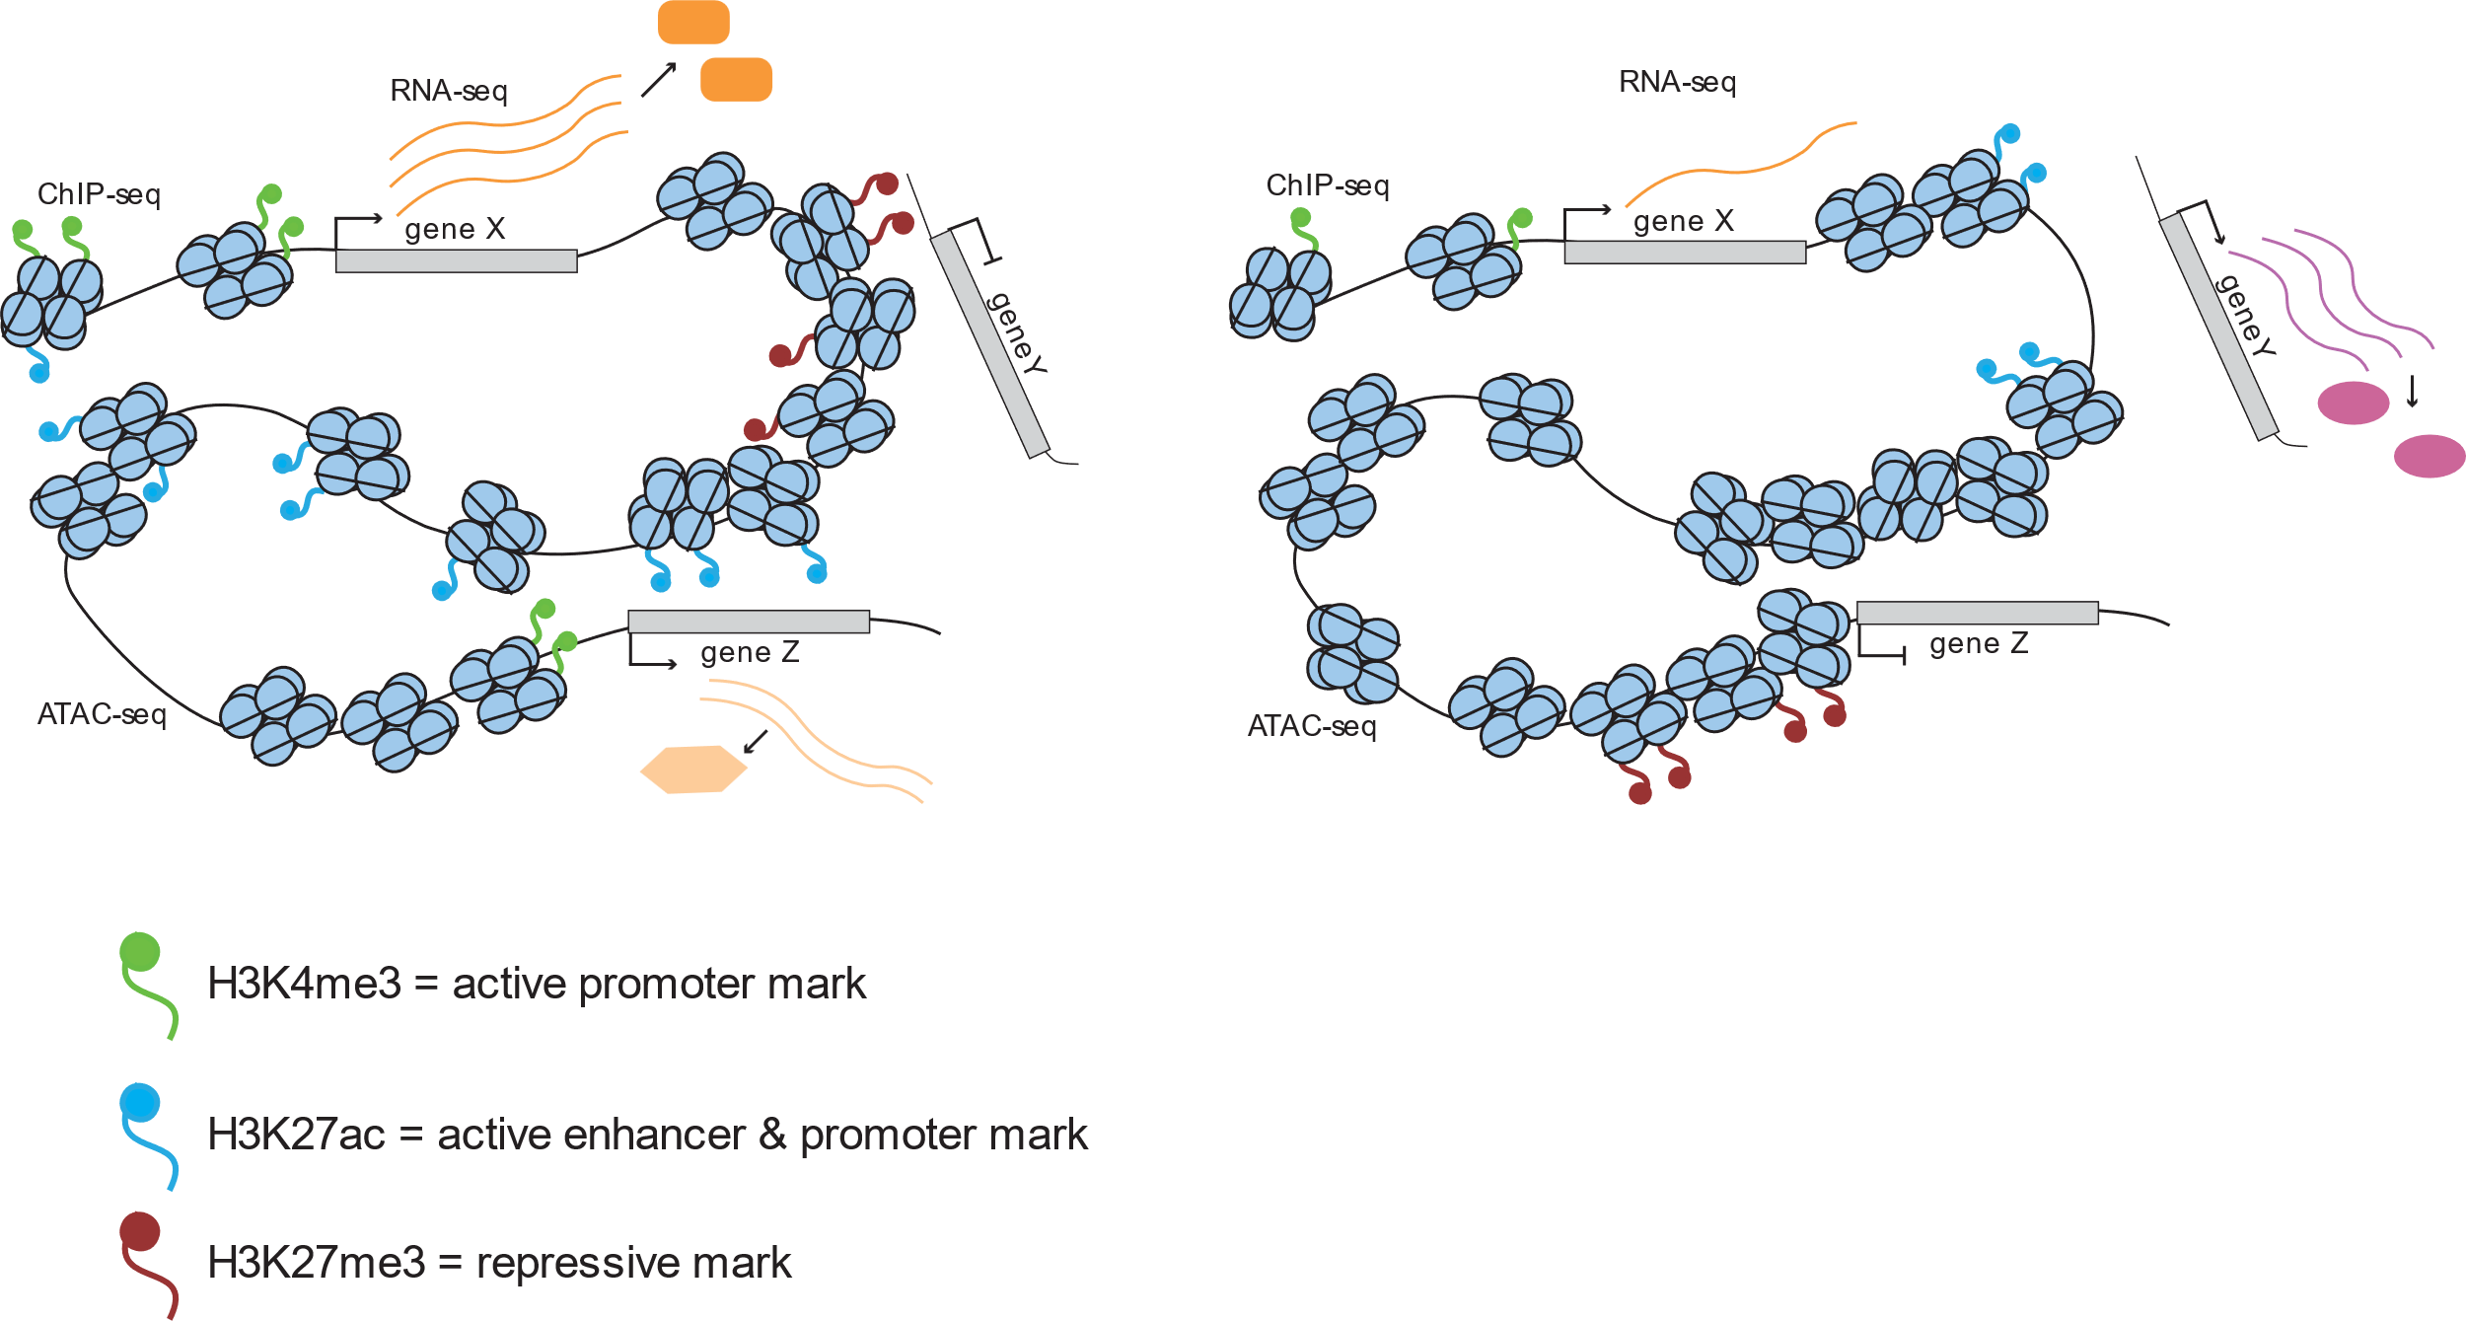
Incorporate Histone marks in motif enrichment,
Even more Intelligently & robust predicting which TFs are binding.

Slide 8
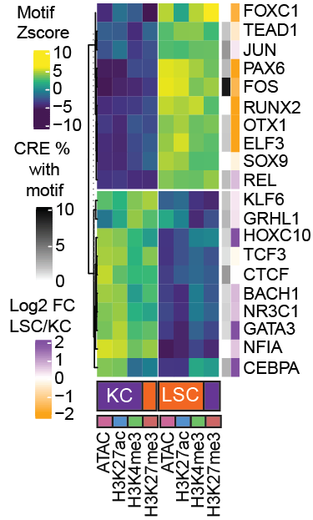
Motif analysis to identify TFs
LSC: PAX6, FOS, ELF3, OTX1 and FOXC1
KC: HOXC10, GATA3 & CEBPA
Factors with low RNA-fold change:
FOS/JUN, CTCF, KLF6
Motif analysis predicts cell type-specific TFs
Which factors are shared between the cell types?
incorporate pluripotent cells
Can we incorporate TF and target gene expression?
Use gene regulatory network analysis

Slide 9
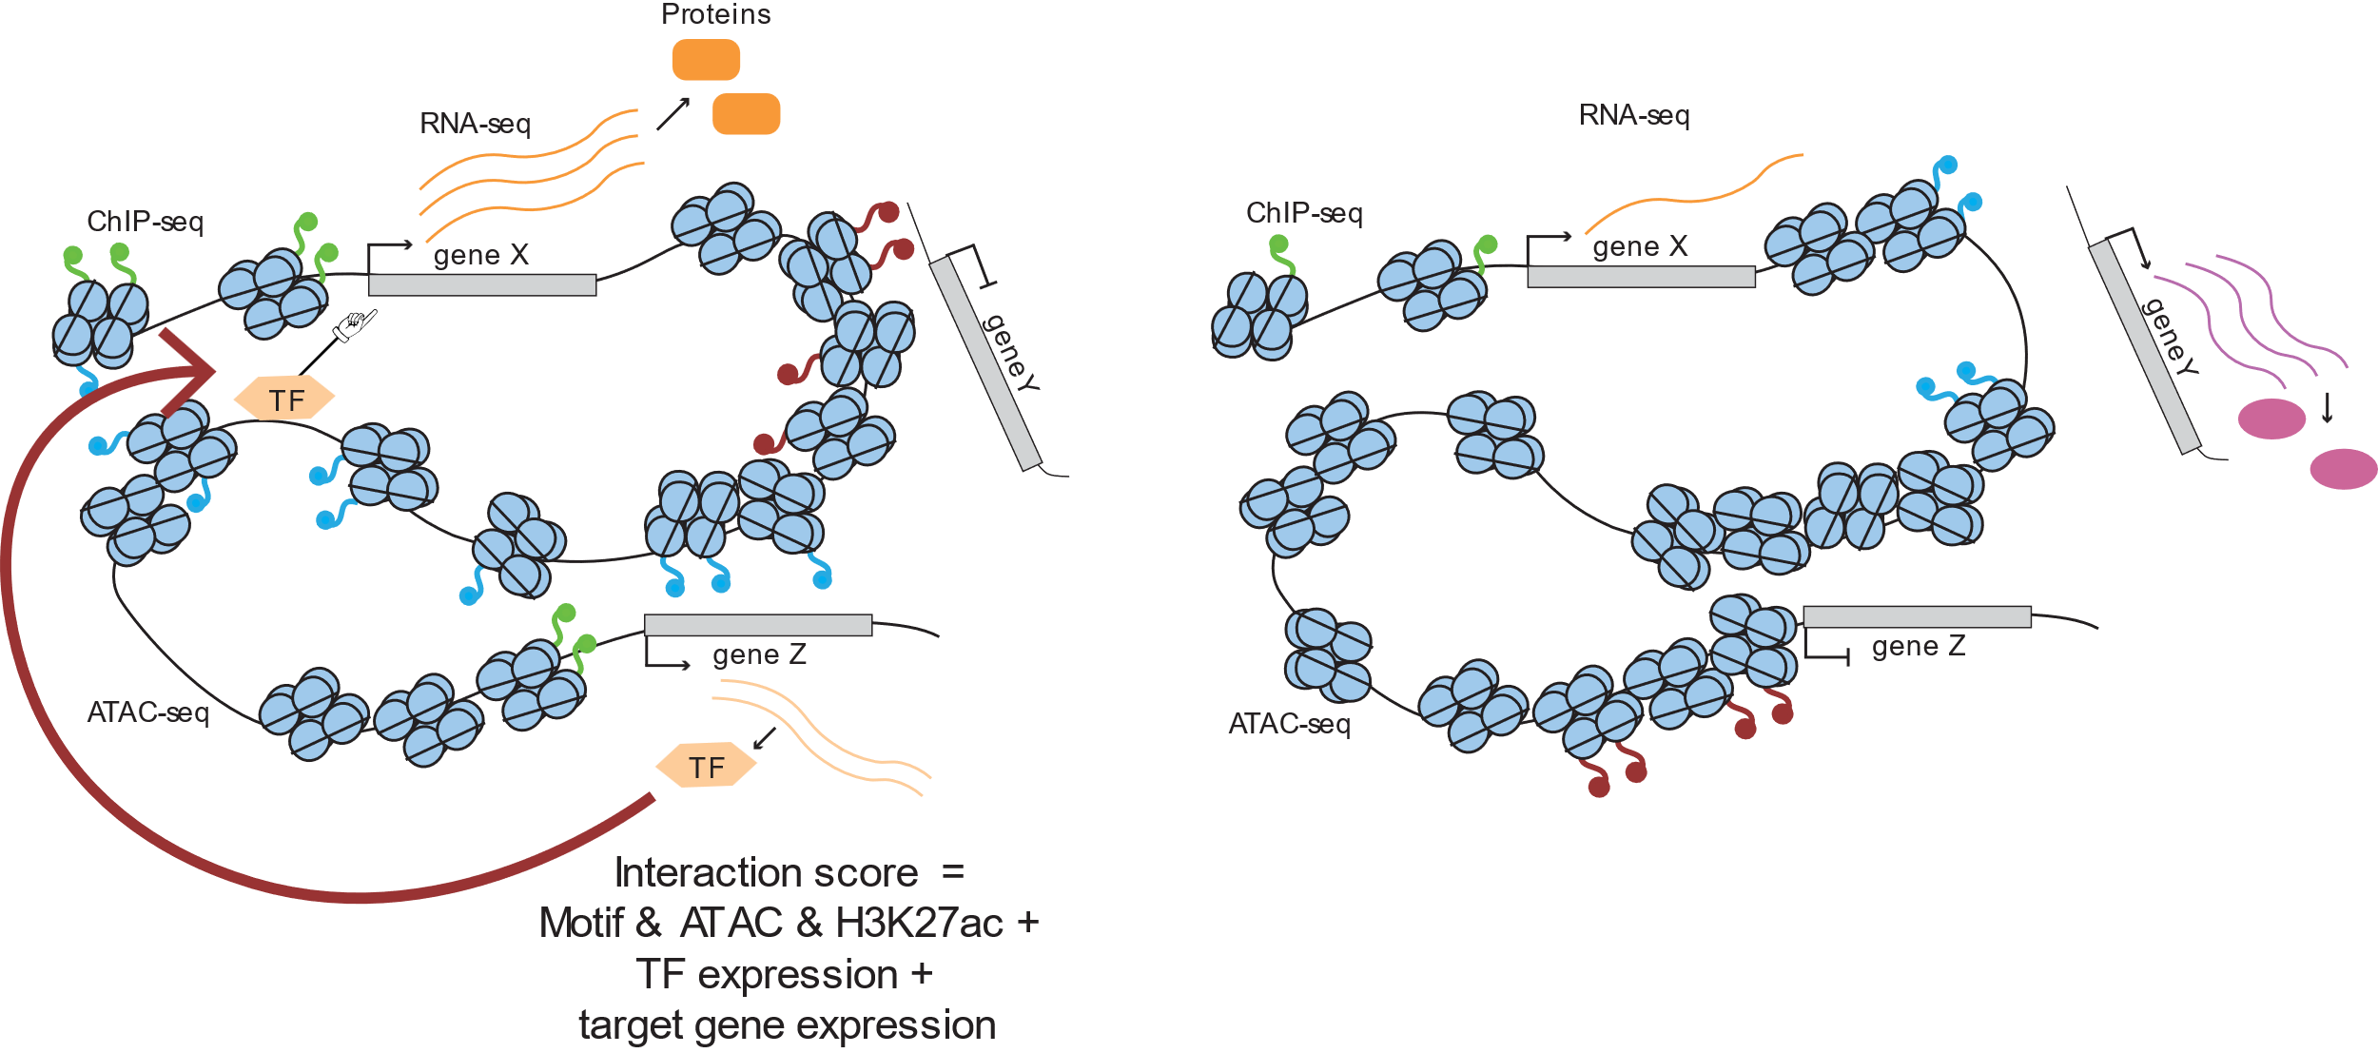
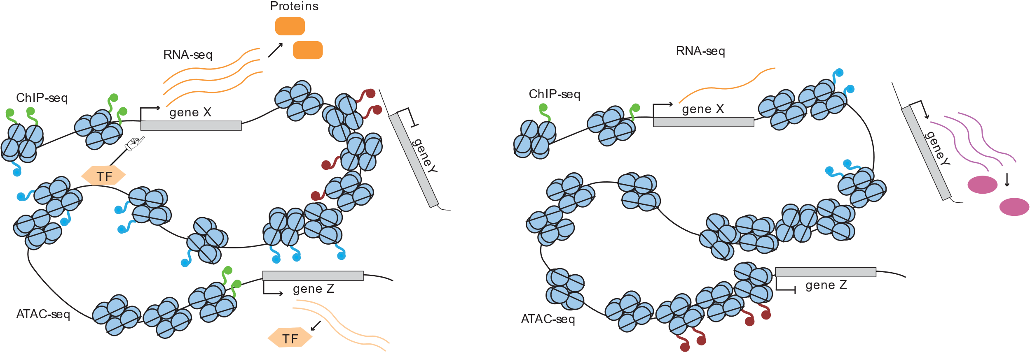
Using GRN analys to rank importance TFs in
ESC-KC and ESC-LSC comparisons

Slide 10
gene regulatory network analysis to identify TFs
Validated expression in human biopsy scRNAseq datasets
What drives the LSC cell fate?
“what makes a LSCs a LSCs?”

Slide 11
What drives the LSC cell fate?
A combination of shared epithelial TFs, and (novel) Limbal specific TFs.
Are the identified TFs relevant for disease?

Slide 12
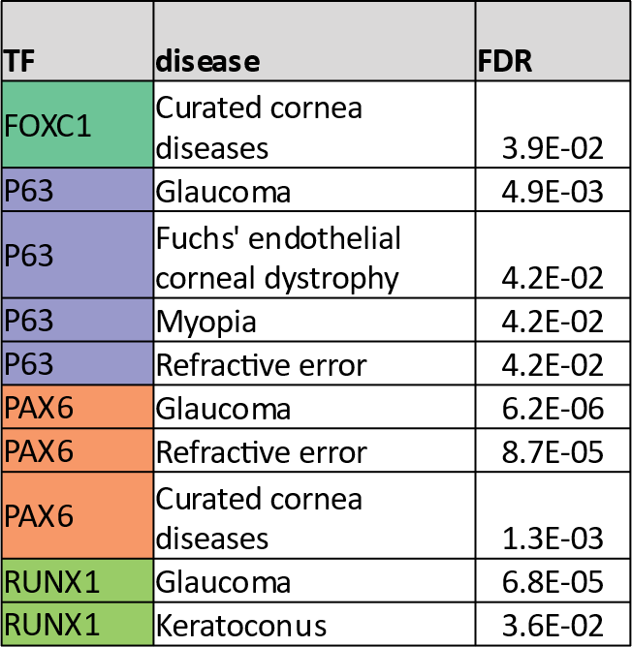
TFs association with corneal disease gens
TF-Chipseq data
Cornea disease genes
Multiple factors enriched
1000 genome database
Novel heterozygous missense variant of FOSL2 in patient with cornea opacity
FOSL2(NM_005253.4):c.628C>T. (p.Arg210Cys)
GenBank | NM_005253.4
Uniprot | P15408
genomicDNA-hg38 | 2-28412095-C-T
cDNA | c.628C>T
AminoAcid | 210
reference AA | R
Alternative AA | c.628C>T
gnomAD allele freq | 0.0000922
Identified many FOS-motifs in 10% of the cis-regulatory elements
Identified FOSL2 as a general epithelial TF
Identified FOSL1 as a LSC specific TF

Slide 13
Conclusions and future outlook
“Multi-omics analysis identifies cooperation of transcription factors controlling the specific epithelial cell fate of the corneal epithelium”
Crucial information for (future) trans-differentiation projects
Identified novel factors and cis-regulatory elements for GWAS research in cornea diseases
TF and epigenome information, relevant for my second project, iPSC to LSC differentiation.

Slide 14
Acknowledgements
Jo Zhou
Felicitas Pardow, poster 69: leflunomide's mechanisme of action in counteracting pathological features of AD in Keratinocytes
Luca Meesters, poster 52, iPSC to Keratinocyte differentiation
Dulce Lima Cunna
Julian Arts
All other Zhou group members
Simon van Heeringen
Maarten van der Sande
Rebecca Snabel
Siebren Fröhlich
All other van Heeringen group members
All other members of :
Molecular developmental biology
Molecular biology
FNWI-Cell biology

