Slide 1
scRNAseq iPSC to iLSC protocol

Slide 2
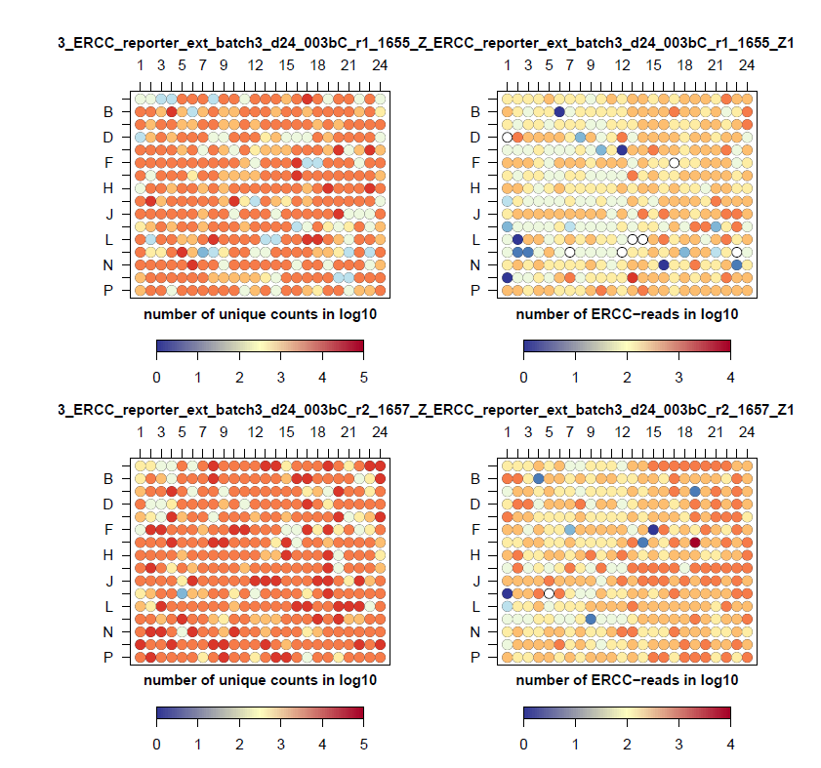
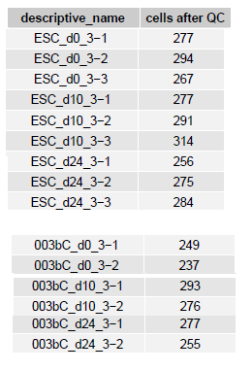
Per plate QC
Batch 3 best quality so far!
Especially many more d11&d24 cells!

Slide 3
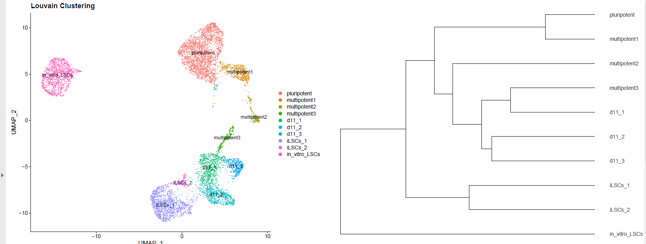
three ‘multipotent’ clusters
three day 11 cluster
Two day 24 ‘proper diff’ clusters

Slide 4
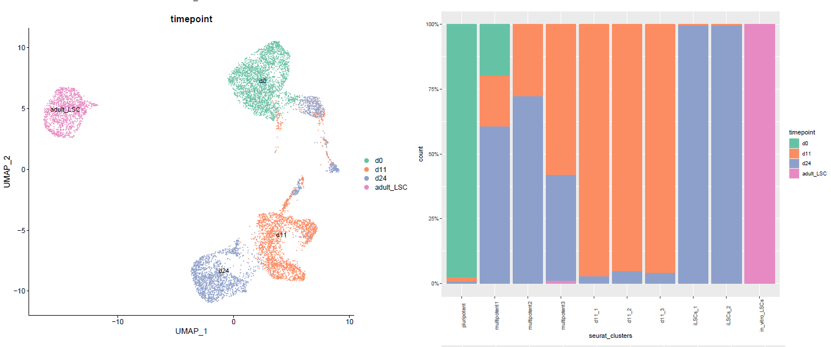
three ‘multipotent’ clusters (remain & proliferate at day 24)
three day 11 clusters (decreased at day 23)
Two day 24 ‘proper diff’ clusters

Slide 5
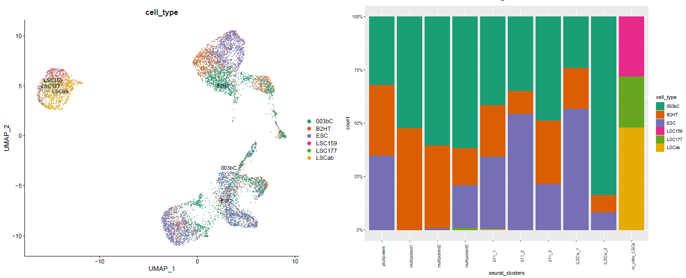
ESC cell line:
  no measured ‘multipotent1’cells
  Very few ‘multipotent2’ cells
  Does contain ‘multipotent3’ cells
Induced LSC clusters:
  Induced LSC1: mostly ESC cells
  Induced LSC2: mostly 003bC cells

Slide 6
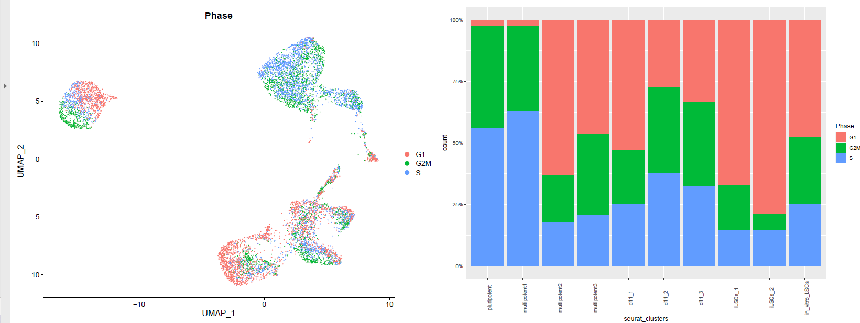
More cell cycle activity in multipotent cluster1, will amplify faster than other cells

Slide 7
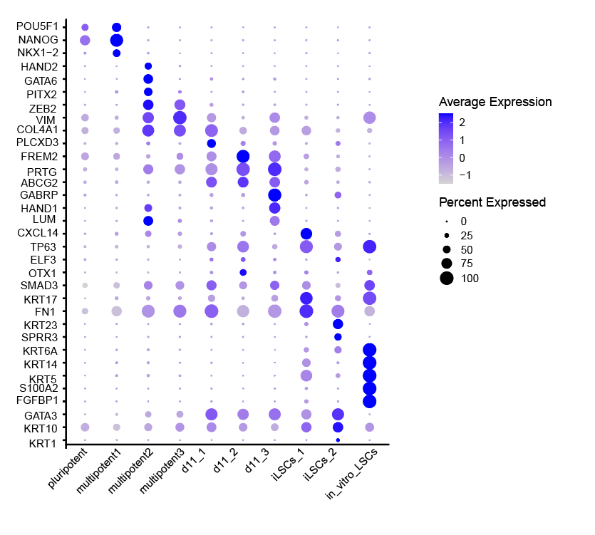
Marker gene expression:

Slide 8
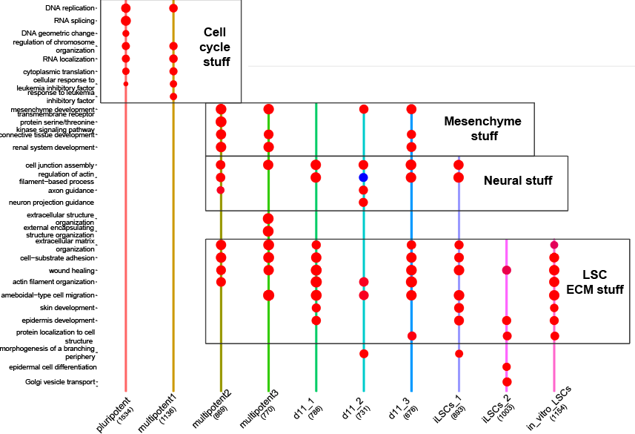
Marker gene Go-term enrichment:
Mesenchymal like:
Multipotent cluster 2
Multipotent cluster 3
D11_2
D11_3
D11_1 most epithelial like

Slide 9
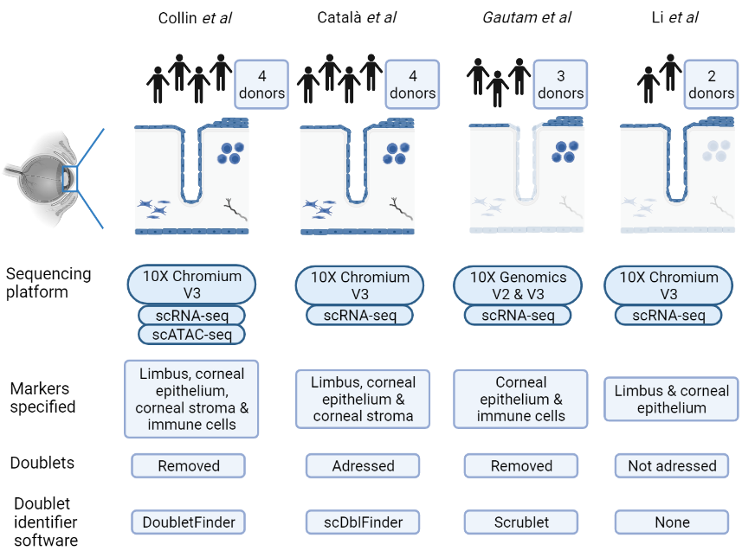


Cornea/eye meta atlas
Notes:
Gautam: expect cells: 6000
First, cells expressing < 15% of mitochondrial genes for all primary tissues datasets
>200 for human donor 72 cornea; 200-8,500 for human donor 73 cornea; 200-6,000 for human donor 76 cornea
Third, cells with less than the following numbers of total UMIs were retained:100K for human donor 72 cornea; 60K for human donor 73 cornea; 30K for human donor 76 cornea
Fourth, we identified doublets using by the python package ‘Scrublet’3 (https://github.com/AllonKleinLab/scrublet) with the default parameters and cells with less than following doublet scores were retained:0.20 for human donor 72 cornea; 0.23 for human donor 73 cornea; 0.23 for human donor 76 cornea
Fifth, genes were retained in the data if they were expressed in ≥ 3 cells. The Seurat’ NormalizeData’ function was used to perform an additional cell-cell normalisation, and the Seurat ‘merge’ function was used to combine the multiple libraries for each analysis.
Collin:
Doubletfinder R? Unclear with which parameters?
1000 reads or 500 genes or greater than 15% mitochondrial reads.
Catala:
More specifically, cells with at least 1000 UMIs per cell and less than 20% mitochondrial gene content were retained for analysis.
Putative doublets were computationally identified using scDblFinder (v1.2.0)⁵⁷.
I will use DoubletFinder as well for all datasets:
https://www.sciencedirect.com/science/article/pii/S2405471220304592

Slide 10
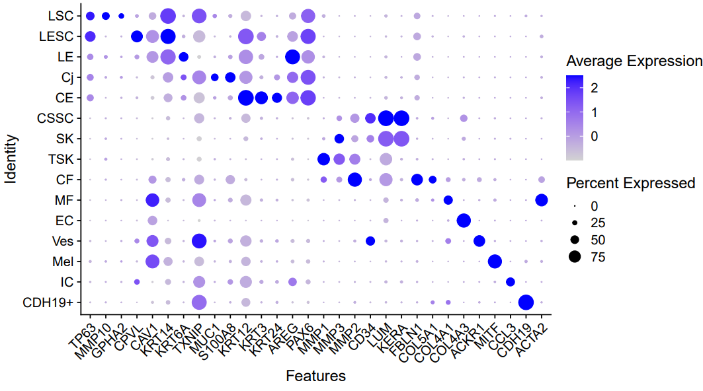

Slide 11
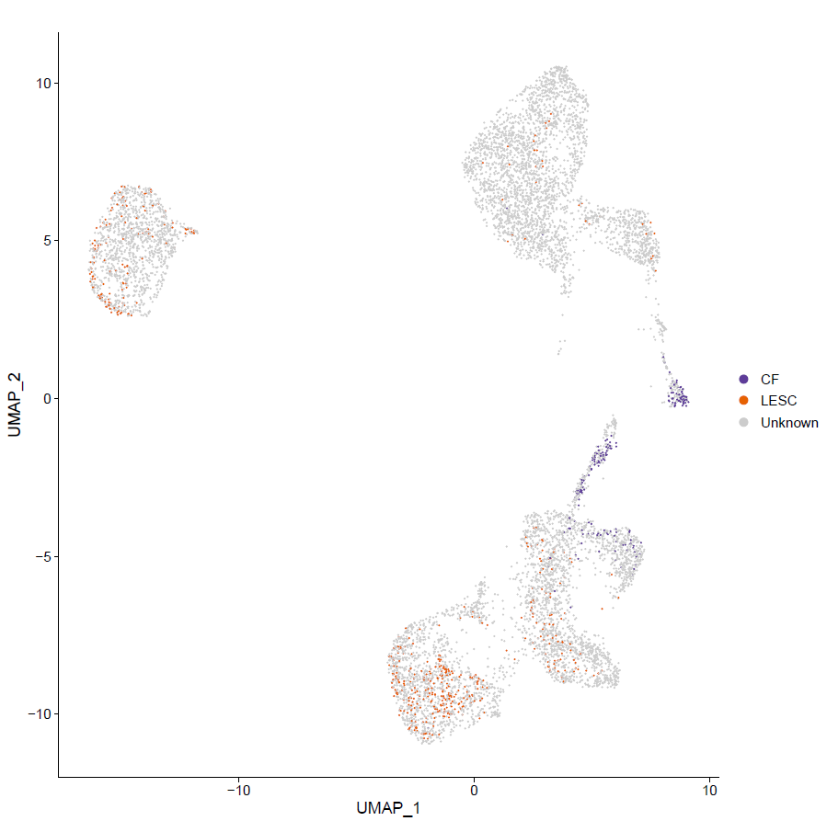
SVM annotation
LESC (proliferative/transient amplifying LSCs):
  In vitro amplified LSCs
  induced LSCs annotate to LESCs (proliferative LSCs)
Corneal fibroblasts:
  Multipotent 2
  multipotent 3
  Day11-3

Slide 12
Gene (list) enrichments
Three different sources:
Progeny signaling pathway target genes
(https://saezlab.github.io/progeny/)
dorothea TF-target gene collection
(https://saezlab.github.io/dorothea/)
mysigDB geneset collections (plural, multiple databases!)
(https://www.gsea-msigdb.org/gsea/msigdb/)
Are genes from source X enriched in the marker gene lists?

Slide 13
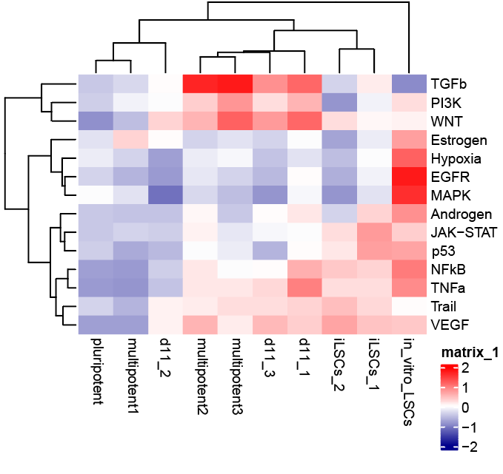
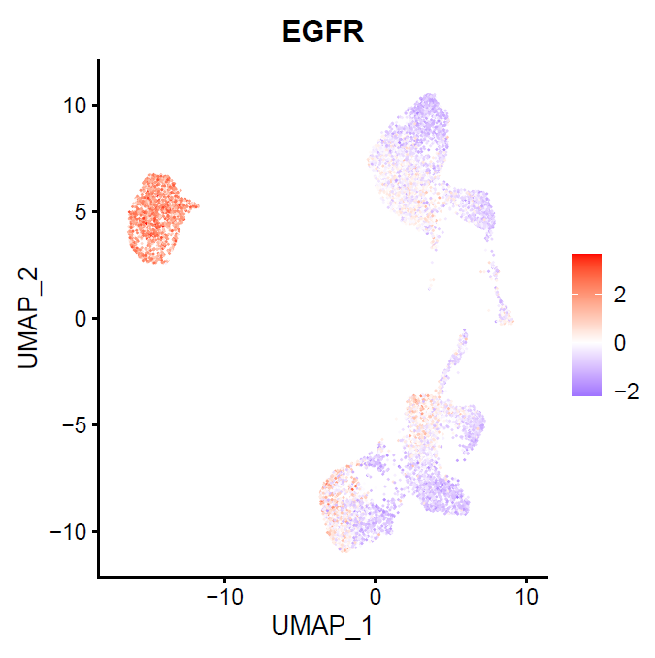
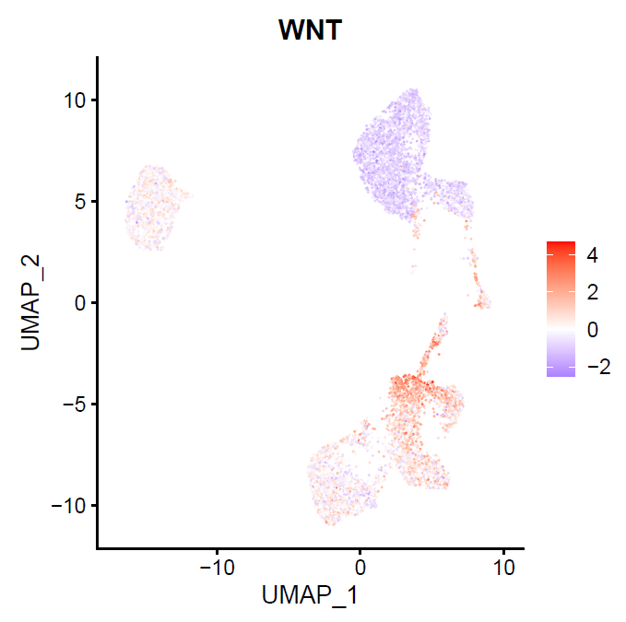
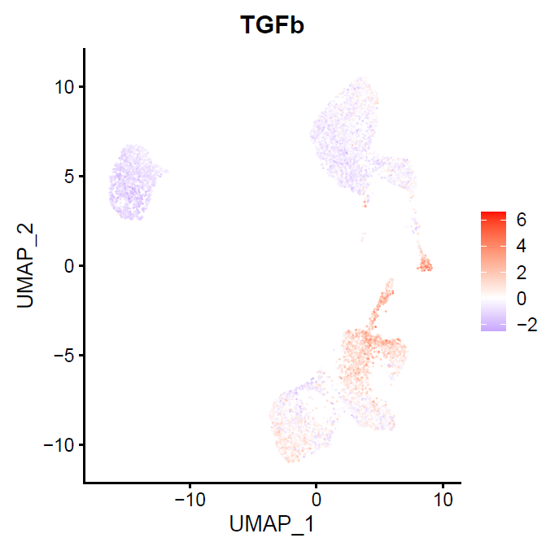
1. Progeny signaling pathway target gene enrichment
Multipotent 2,3 and d11-1,3 are enriched for: TGFB, PI3K & WNT
In vitro LSC & iLSC_1 are enriched for EGFR
Potentially inhb. WNT during differentiation?

Slide 14
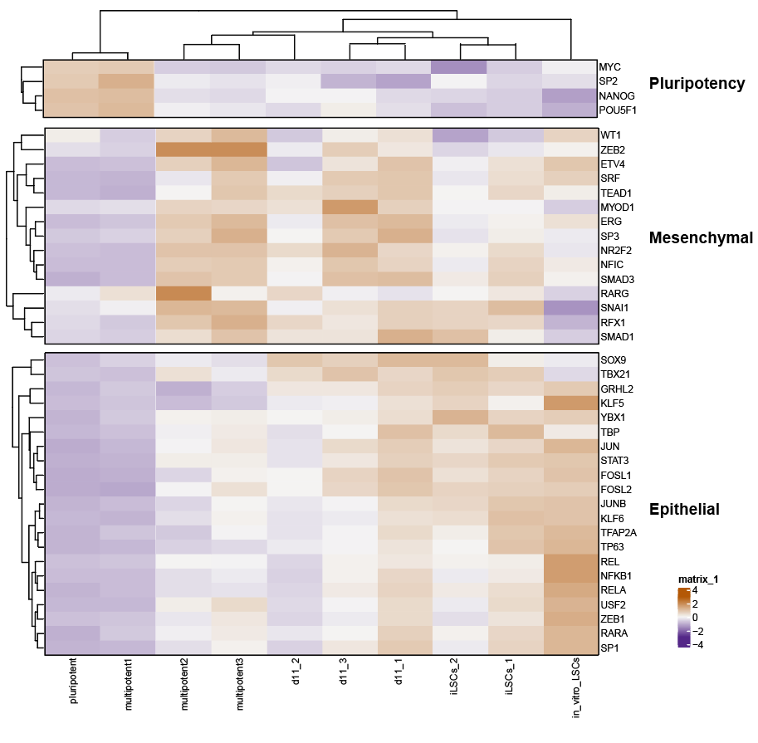
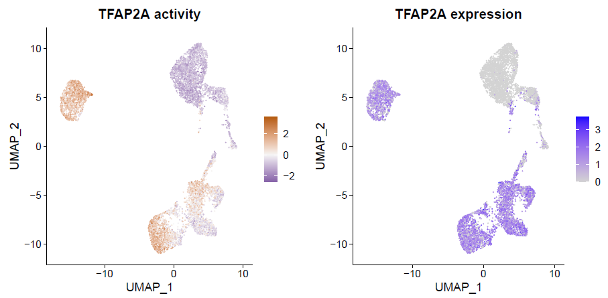
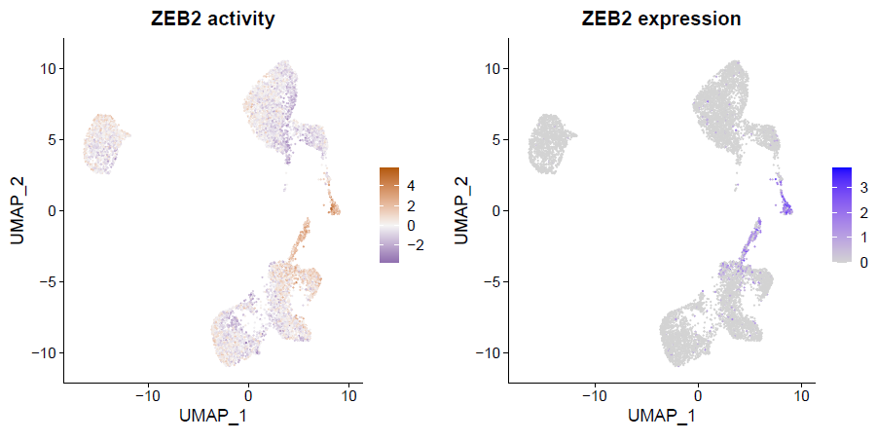
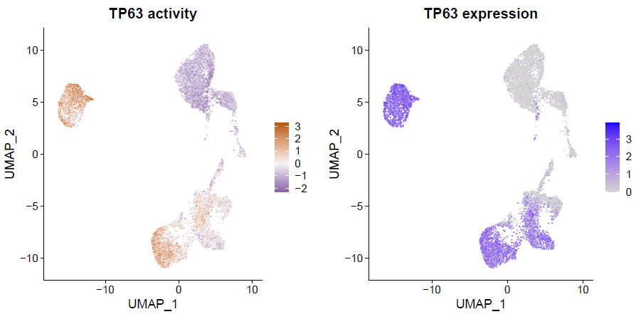
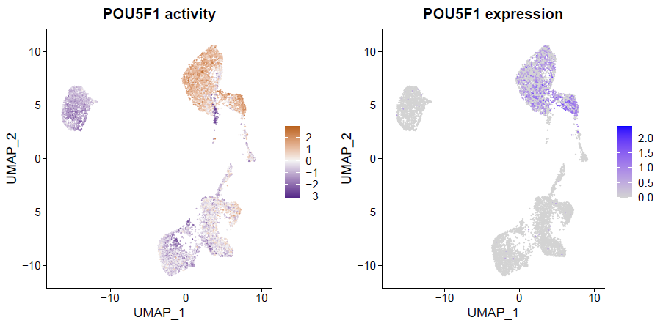
2. Dorothea TF target gene enrichment
Pluripotency TFs target genes are enriched in pluripotent 1 & multipotent 1
Mesenchymal TFs target genes are enriched in multipotent 2,3 d11 1,2&3
(ZEB2, NR2F2, SNAI1)
Epithelial and general TFs target genes are enriched in d11_1 iLSC and in vivo LSCs
(TFAP2A, TP63, KLF5-6, GRHL2, RARA, REL, NFKB1, JUN)

Slide 15
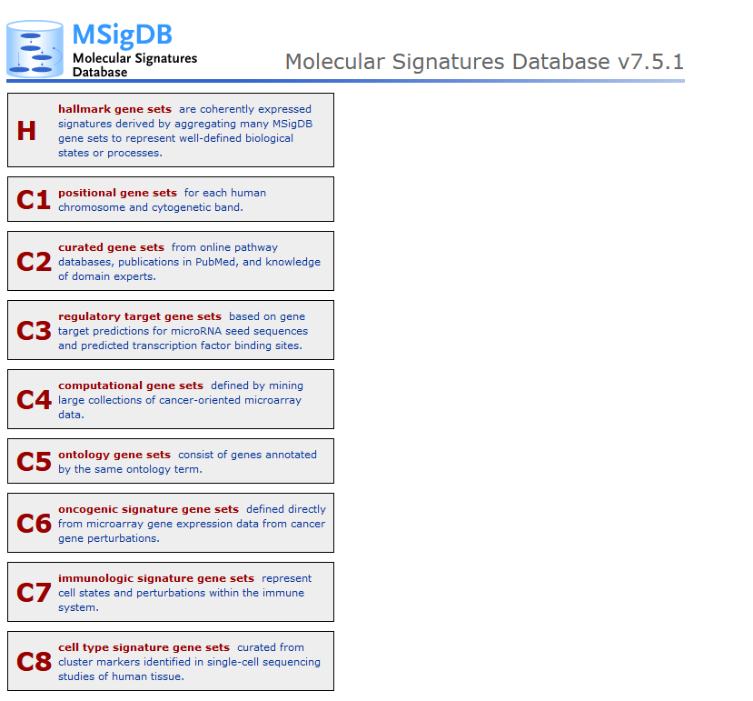
2. MSigDB gene sets
Databases of most interest:
H (Hallmark gene sets, well defined biological states or process)
C2, Curated gene sets
C8, cell type signature gene sets

Slide 16
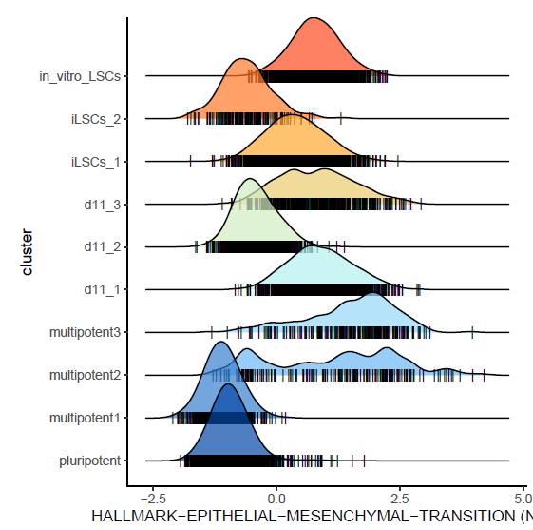
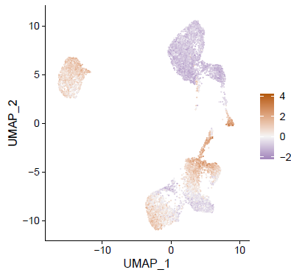
Notabale Halmark geneset enriched:
EMT transition:

Slide 17
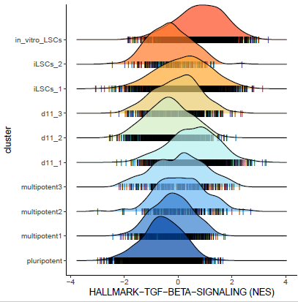
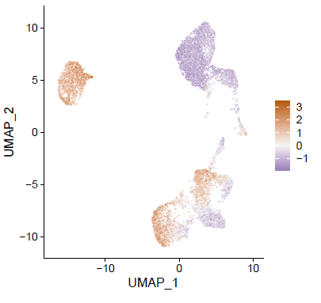
TNF sign via NFKB:

Slide 18
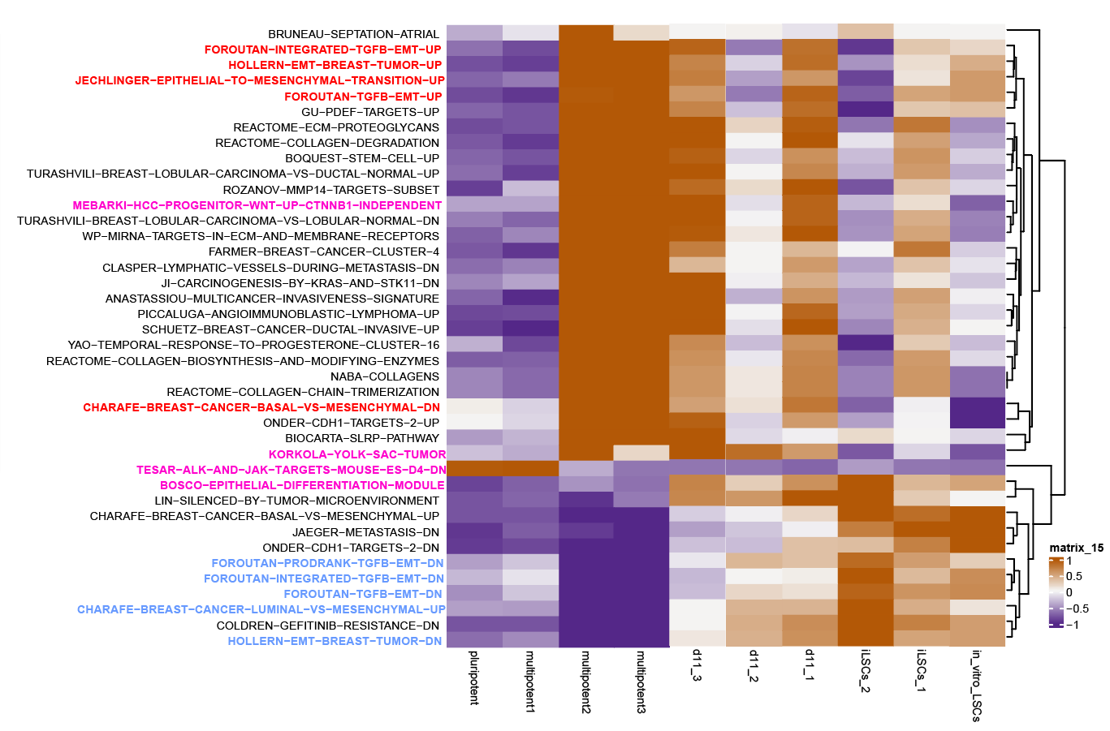
Notabale C2 curated genesets enriched:

Slide 19
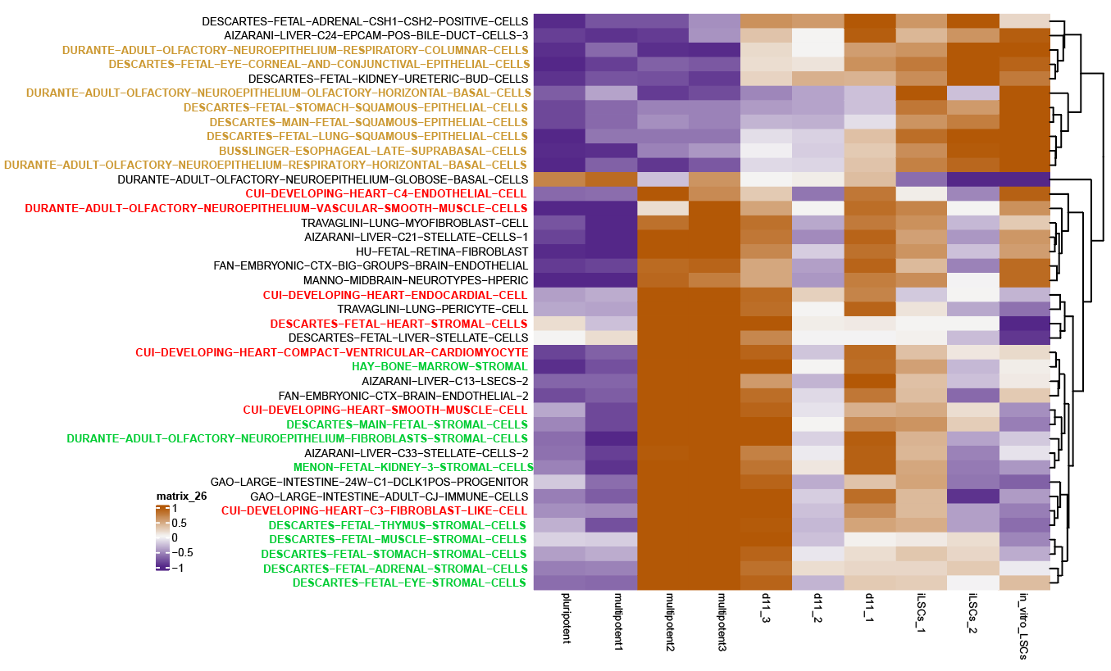
Notabale C8 cell type signatures:

Slide 20
Specific comparisons:
Pluripotent vs multipotent1
iLSC1 vs iLSC2
iLSCs vs in vitro LSCs

Slide 21
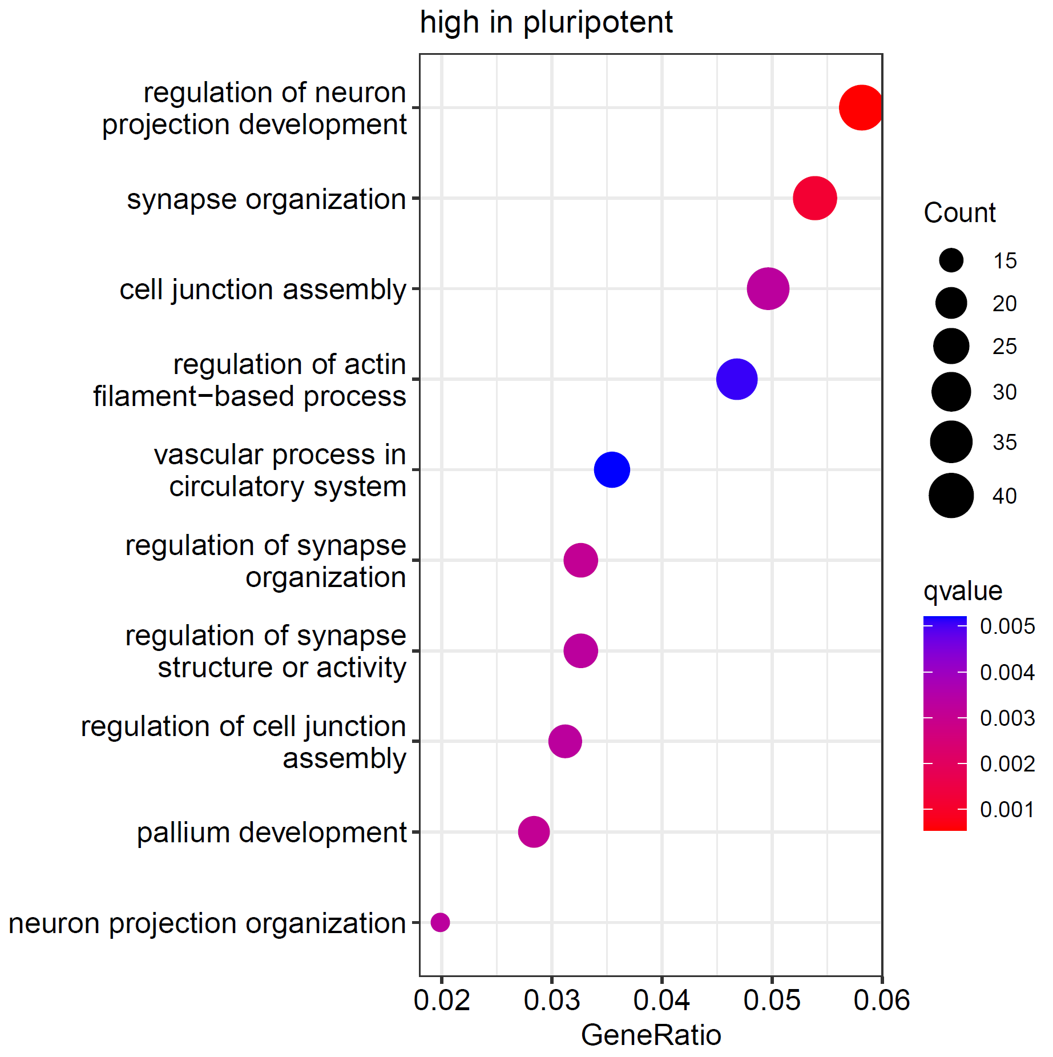
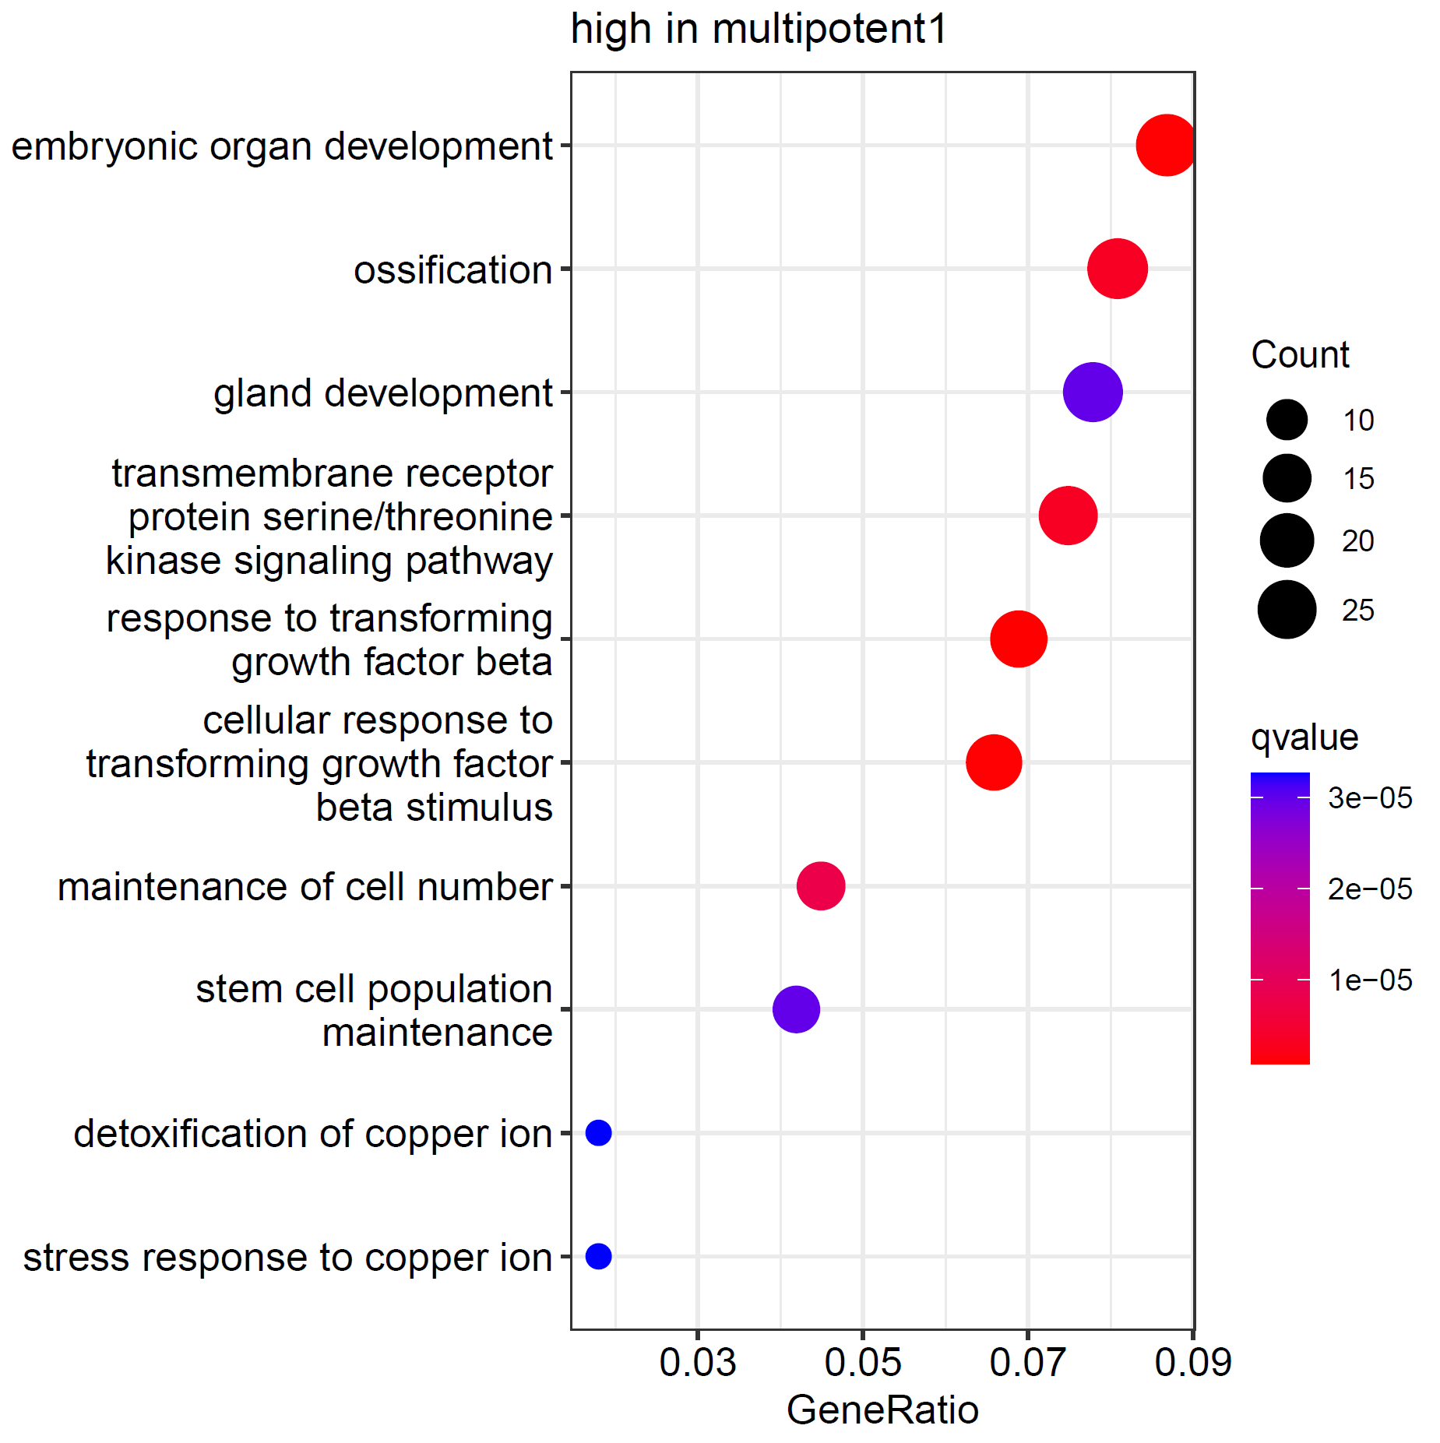
Pluripotent
Multipotent1
p_val | avg_log2FC | p_val_adj
SFRP1 | -1.97127405 | 5.25E-259
USP9X | -1.5104383 | 7.44E-119
TRDN | -1.50395477 | 3.62E-168
DUSP6 | -1.44606125 | 2.36E-86
FZD7 | -1.44494588 | 2.07E-149
GPR176 | -1.3188623 | 7.03E-107
ROBO2 | -1.29646811 | 7.73E-60
TPM1 | -1.26807237 | 1.42E-135
CCN2 | -1.265254 | 5.30E-81
ESYT2 | -1.21371563 | 1.24E-59
PYY | -1.2006716 | 8.15E-57
AASS | -1.1662658 | 7.26E-124
NR6A1 | -1.1092893 | 8.22E-117
NLGN1 | -1.00845089 | 2.84E-53
RIPOR2 | -1.00424185 | 1.95E-59
ASIC2 | -0.99979206 | 2.60E-57
MMP16 | -0.99691415 | 1.75E-70
VCL | -0.98820839 | 1.11E-71
p_val | avg_log2FC | p_val_adj
LRFN5 | 2.442144079 | 0
MT1G | 2.342101687 | 7.03E-286
DMD | 2.256069207 | 0
MT1H | 1.982567397 | 5.87E-213
MT1E | 1.675029564 | 1.59E-254
MT2A | 1.658502841 | 1.69E-243
MT1F | 1.57158873 | 7.32E-290
HPGD | 1.505355089 | 3.08E-130
CR1L | 1.431327571 | 1.04E-191
SERPINB9 | 1.383166102 | 2.98E-57
NETO2 | 1.353756101 | 2.45E-223
KAZN | 1.2024531 | 1.01E-109
SATB2 | 1.143320428 | 9.11E-167
MECOM | 1.113334156 | 6.67E-112
NRG3 | 1.095480727 | 1.97E-80
MDK | 1.055137465 | 1.21E-141
PDGFA | 1.021474733 | 7.55E-143
COL6A1 | 1.010656256 | 1.60E-156

Slide 22
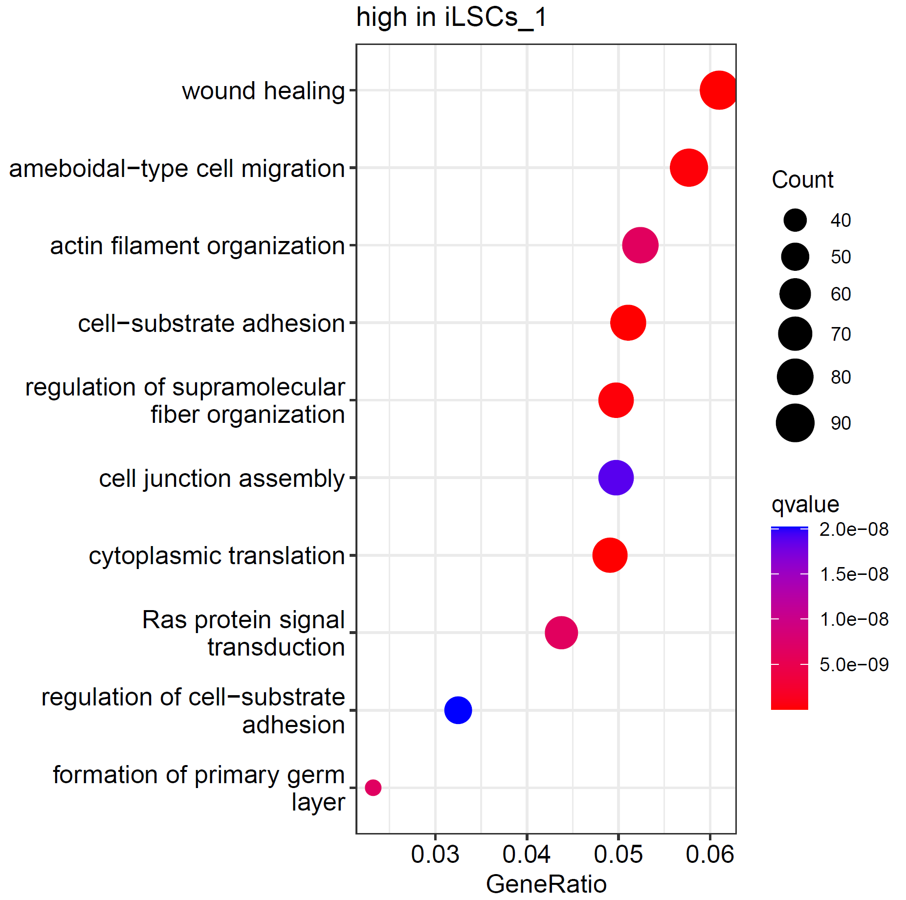
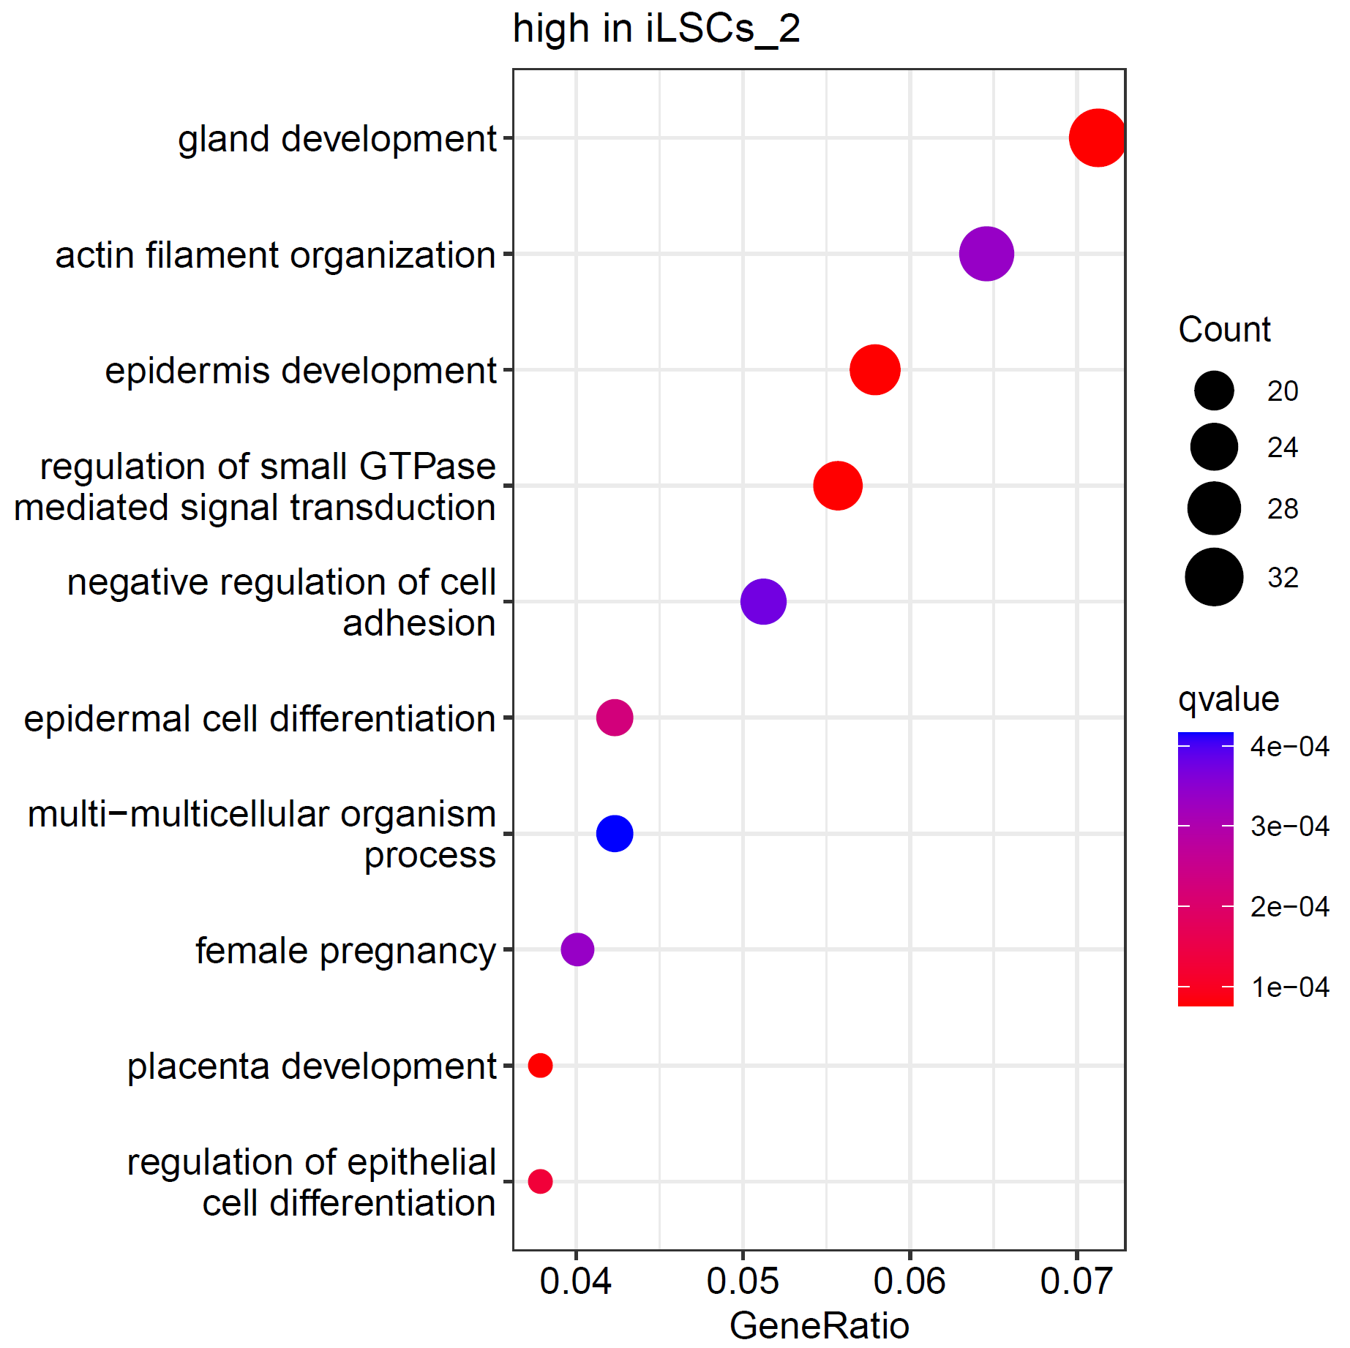
iLSC_1
iLSC_2
Kolom1 | avg_log2FC | p_val_adj
CGA | -4.09543054 | 1.24E-42
CDKN1C | -3.59779786 | 9.84E-102
SPP1 | -3.51383442 | 2.57E-77
SERPINB2 | -2.56691966 | 9.53E-25
SPRR3 | -2.55082638 | 3.78E-39
MBNL3 | -2.33531826 | 1.30E-91
S100P | -2.31012841 | 3.85E-93
MUC16 | -2.27799186 | 1.62E-126
CD24 | -2.14292322 | 1.48E-123
DAB2 | -2.12684791 | 4.65E-60
KRT1 | -2.0794262 | 1.64E-19
GABRP | -1.99847934 | 3.64E-45
KRT23 | -1.94028782 | 1.05E-24
S100A9 | -1.93811096 | 1.65E-21
NEBL | -1.90312923 | 3.66E-86
SLC40A1 | -1.85748343 | 3.82E-46
RAB11FIP1 | -1.81869267 | 3.79E-102
PHLDA2 | -1.75482464 | 1.20E-40
Kolom1 | avg_log2FC | p_val_adj
ITGA6 | 3.836617687 | 5.54E-181
CXCL14 | 3.258071012 | 2.54E-85
TNC | 3.116745569 | 8.19E-92
CAV1 | 2.966404804 | 4.23E-133
TENM2 | 2.955489304 | 3.14E-101
FRMD6 | 2.512125876 | 7.68E-91
EXT1 | 2.433347114 | 7.34E-98
KRT17 | 2.385676963 | 2.94E-65
CCN1 | 2.211942156 | 2.64E-54
LAMC2 | 2.207383371 | 1.13E-57
IGFBP5 | 2.137033389 | 3.96E-35
COL5A2 | 2.095068883 | 2.27E-85
SPARC | 2.090158402 | 5.35E-120
KRT5 | 2.079481464 | 9.64E-41
HMGA2 | 1.981498003 | 5.94E-88
PCDH7 | 1.973835892 | 6.86E-69
PDE4D | 1.965670915 | 4.19E-63
KRT14 | 1.935088807 | 2.93E-32

Slide 23
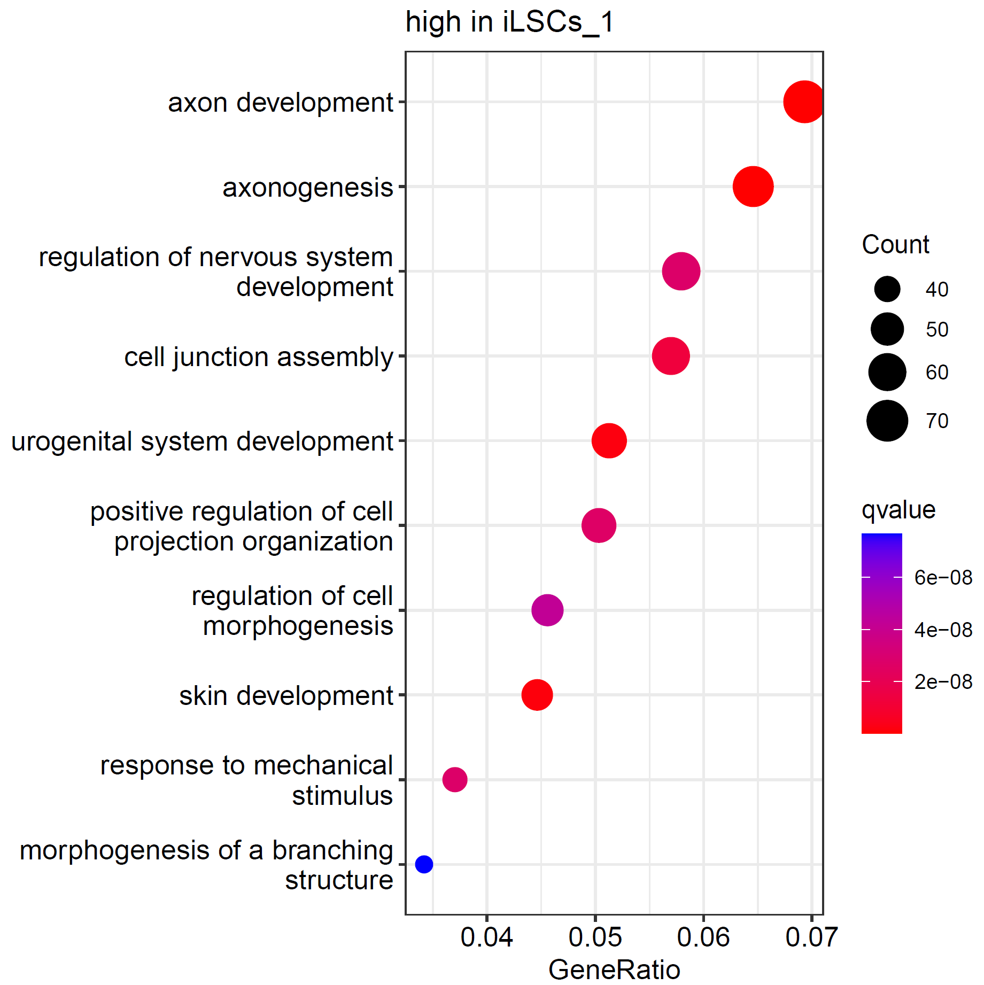
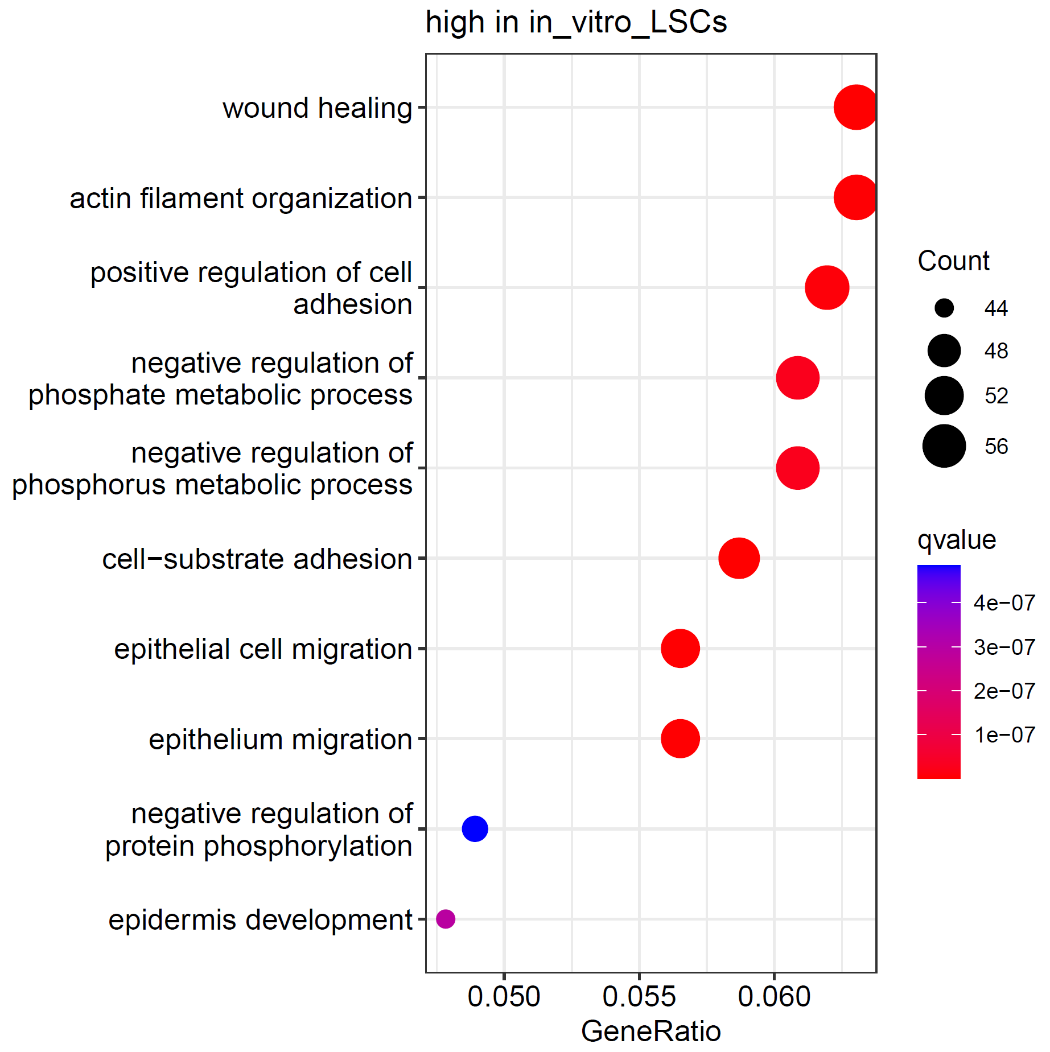
iLSC_1
in vitro expanded LSCs
Kolom1 | avg_log2FC | p_val_adj
CXCL14 | -4.09869844 | 0
FN1 | -3.12821591 | 0
LOC112267876 | -2.85784635 | 8.91E-253
NREP | -2.64815483 | 0
RHOBTB3 | -2.64330752 | 0
COL1A2 | -2.6418155 | 3.06E-107
TPM1 | -2.46628107 | 0
IGFBP5 | -2.4024387 | 6.86E-140
AMOT | -2.35720218 | 1.53E-57
MEIS2 | -2.35215622 | 0
SEMA3D | -2.33525116 | 1.38E-225
PTGS2 | -2.31623106 | 2.19E-278
COL5A2 | -2.28394907 | 0
ARL15 | -2.28300452 | 0
PBX1 | -2.25829964 | 0
GPC6 | -2.18661859 | 0
GULP1 | -2.12867357 | 0
IGFBP3 | -2.0520396 | 2.59E-80
Kolom1 | avg_log2FC | p_val_adj
S100A2 | 5.10294878 | 0
FGFBP1 | 3.918197932 | 0
KRT6A | 3.691411262 | 0
THBS1 | 3.297685006 | 0
KRT14 | 3.235561855 | 0
MT2A | 2.741125548 | 0
DCBLD2 | 2.686948707 | 0
LAMC2 | 2.571583933 | 0
LAMA3 | 2.5358021 | 0
F3 | 2.47077614 | 0
KRT5 | 2.339058399 | 0
NRG1 | 2.270841438 | 1.24E-302
GAS7 | 2.174490868 | 0
CD44 | 2.083771615 | 0
VIM | 2.044088971 | 0
MYO1B | 2.02949493 | 0
LAMB3 | 1.974566449 | 0
ALDH1A3 | 1.915968749 | 1.10E-282

Slide 24
What is next?
Do we want to reduce the identified sub-populations? Are the mesodermal/fibroblast like populations biologically relevant (corneal organoids?)
Try to reduce EMT during the protocol?
  Wnt inhibitors
  Mesodermal inhibitors?
Is it possible to further improve the iLSC to become more LSC like cells?

